Slide 1

Common Prescription Errors in Pediatric CRRT: a “Top 10 List”
8th International Conference On
Paediatric Continuous Renal Replacement Therapy (pCRRT)
16th - 18th July 2015
Queen Elizabeth II Conference Centre, London, UK
Jordan M. Symons, MD
University of Washington School of Medicine
Seattle Children’s Hospital
Seattle, WA - USA

Slide 2
Prescribing Pediatric CRRT
Multiple components to CRRT prescription
  Vascular access
  Hemofilter
  Prime
  Blood pump speed (Q_{B})
  Anticoagulation
  Modality (convection/diffusion/combination)
  Infused fluids – rate and content
  Ultrafiltration rate
Planning ahead may reduce risks

Slide 3

“Top 10 Things You’d Rather Not Say When Prescribing CRRT”

Slide 4
“We can dialyze through any access you have”
Number 10
Top 10 Things You’d Rather Not Say When Prescribing CRRT

Slide 5
Vascular Access Issues
Long skinny catheters don’t flow well
  Resistance ~ 8lη/2r⁴
  Umbilical lines are a poor choice
“Dialysis-grade” catheters necessary
  Stiffer catheter – won’t collapse
Newer technologies – more options?
Importance of communication with those who will place vascular access

Slide 6
“Aren’t all those filters pretty much the same?”
Number 9
Top 10 Things You’d Rather Not Say When Prescribing CRRT

Slide 7
Hemofilter Issues
Characteristic | Options
Prime Volume | <30 ml to >180 ml (incl. tubing)
Surface Area | 0.25 m² to 1.4 m²
Membrane Material | Polysulfone, AN-69, PAES, etc.
Risks for complications (extracorporeal volume, membrane reactions)
Plan ahead – develop standard approaches to common clinical situations

Slide 8
“Just blood prime the baby, it’s easy!”
Number 8
Top 10 Things You’d Rather Not Say When Prescribing CRRT

Slide 9
Circuit Priming Issues
Saline, blood/albumin, albumin alone (?)
Technical challenges – need policies, protocols, practice
Risks to patient:
  Volume/blood pressure
  Blood product exposure
Develop plans, adjusting appropriately for the clinical situation

Slide 10
“Blood pump speed – isn’t there an equation for that?”
Number 7
Top 10 Things You’d Rather Not Say When Prescribing CRRT

Slide 11
Blood Pump Speed Issues
Suggested methods to determine blood flow rate (Q_{B}) for pediatric CRRT have included:
Calculation: | Table:
3-5ml/kg/min | 0-10 kg: 25-50ml/min 11-20kg: 80-100ml/min 21-50kg: 100-150ml/min >50kg: 150-180ml/min
The real determinant – the vascular access
Plan ahead based on your access, device requirements – doctors, ask the nurses!

Slide 12
“Citrate – it’s just like heparin, only safer”
Number 6
Top 10 Things You’d Rather Not Say When Prescribing CRRT

Slide 13
Anticoagulation Issues
Heparin | Citrate | Prostacyclin
Bleeding Heparin-induced thrombocytopenia | Citrate accumulation Acid/base problems Calcium abnormalities Blood flow/clearance rate discrepancies | Hypotension Cost
Understand your protocol(s)
Teach your colleagues (physicians and nurses) about potential complications
Advanced planning and careful monitoring will limit problems

Slide 14
“Talking to the pharmacist and the nutritionist makes me anxious . . .”
Number 5
Top 10 Things You’d Rather Not Say When Prescribing CRRT

Slide 15
Convection Favors Loss of Larger Molecules
CRRT prescription without thoughtful consideration of nutritional needs and medication requirements puts patients at risk for poor outcome
Small molecules and drugs
Middle molecules and drugs
Larger molecules and drugs
Very large molecules and drugs

Slide 16
“There’s a label on the solution bag? I’ve never read that . . .”
Number 4
Top 10 Things You’d Rather Not Say When Prescribing CRRT

Slide 17
Issues with the Biochemical Profile of Infused CRRT Fluids
Patient’s blood chemistry approaches that of infused fluids
Errors in fluid content (mixing or inappropriate choice for situation) can lead to significant abnormalities
x
x

Slide 18
“Infused fluid rate – there’s an equation for that too, right?”
Number 3
Top 10 Things You’d Rather Not Say When Prescribing CRRT

Slide 19
Issues with Infused Fluid Rates
2000 – 3000 ml/hr/1.73m²
Effluent flow (infused fluids + UF) approximately equals CRRT clearance
  Unlike IHD, solution rate is limiting factor
  Too low: poor clearance, accumulation of unwanted molecules (e.g. citrate)
  Too high: more loss of electrolytes, drugs
Consider your patient and clinical goals when prescribing fluid rates

Slide 20
“I’m sure we can achieve any UF target you want”
Number 2
Top 10 Things You’d Rather Not Say When Prescribing CRRT

Slide 21
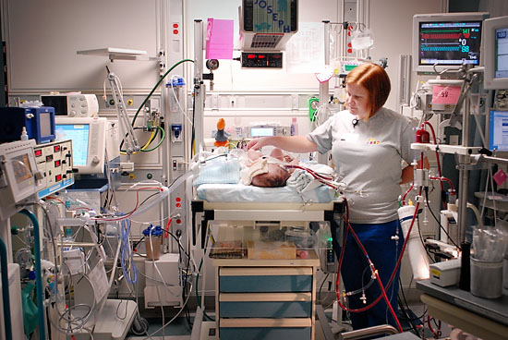
Issues with Ultrafiltration

Slide 22
Issues with Ultrafiltration
Overly aggressive UF:
  Hypotension, additional volume to patient
Insufficient UF:
  Persistent volume excess; hypertension
Thoughtful consideration of clinical goals and careful communication between services will prevent complications

Slide 23
“CRRT? For this kid? Sure, whatever you want . . .”
Number 1
Top 10 Things You’d Rather Not Say When Prescribing CRRT

Slide 24
Is CRRT Always the Right Choice?
A powerful, life-saving therapy
BUT – not without risks
Consider options carefully, individually:
  Peritoneal dialysis?
  Intermittent HD?
  Conservative management?
  CRRT?
Do what is best for your patient

Slide 25
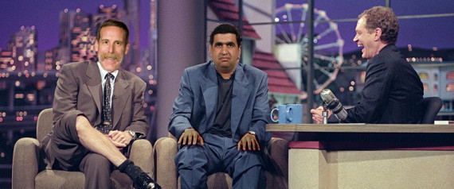
Thanks for your attention!
Tim and Akash have some fun on set with Dave

