Slide 1
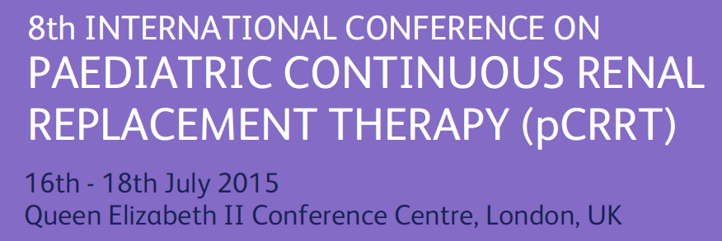
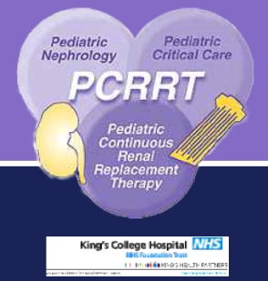

"AKI in Critical Care: epidemiology and definitions"
Stefano Picca, MD
Department of Nephrology and Urology, Dialysis Unit
“Bambino Gesù” Pediatric Research Hospital, IRCCS
ROMA, Italy

Slide 2
AKI IN CRITICAL CHILDREN : EPIDEMIOLOGICAL ISSUES

Slide 3
1985-1997
from Flynn JT, 2002

Slide 4
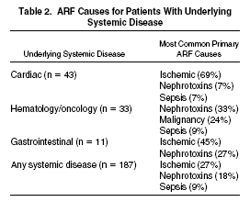
…Primary renal diseases accounted for only 17 cases (7%; acute glomerulonephritis
[9 patients], pyelonephritis [5 patients], and hemolytic uremic syndrome [3 patients]).
Hui-Stickle S, 2004

Slide 5
CHANGE IN THE EPIDEMIOLOGY OF AKI (1)
Broadening of pediatric AKI epidemiology:
due to morbidity deriving from new complex treatments
(heart surgery, BMT, liver and heart tx, etc)
More critical children with AKI receiving
Intensive Care

Slide 6
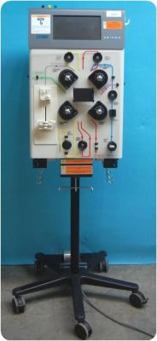
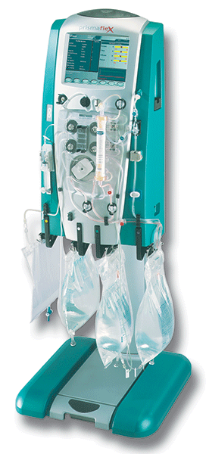
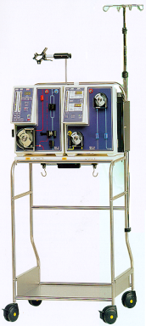
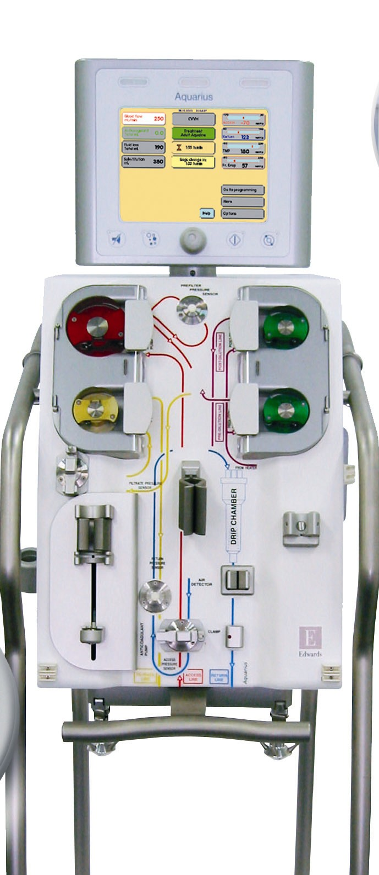
CHANGE IN THE EPIDEMIOLOGY OF AKI (2)
Single organ failure
MODS
+
Primary renal disease
AKI as complication
of
systemic diseases
Renal ward/
Dialysis Unit
ICU
Courtesy of E. Vidal, modified
Notes:
So this has profoundly affected our conception of AKI and our routine…In fact we have passed from considering ourselves involved in treating a single…

Slide 7
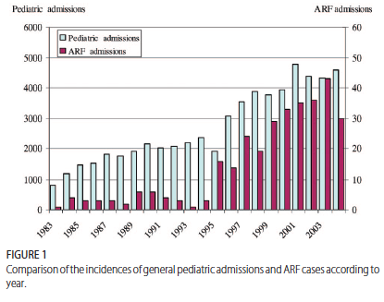
AKI OR AKI RECOGNITION IS INCREASING
Vachvanichsanong et al, Pediatrics, 2006 (THAILAND)

Slide 8
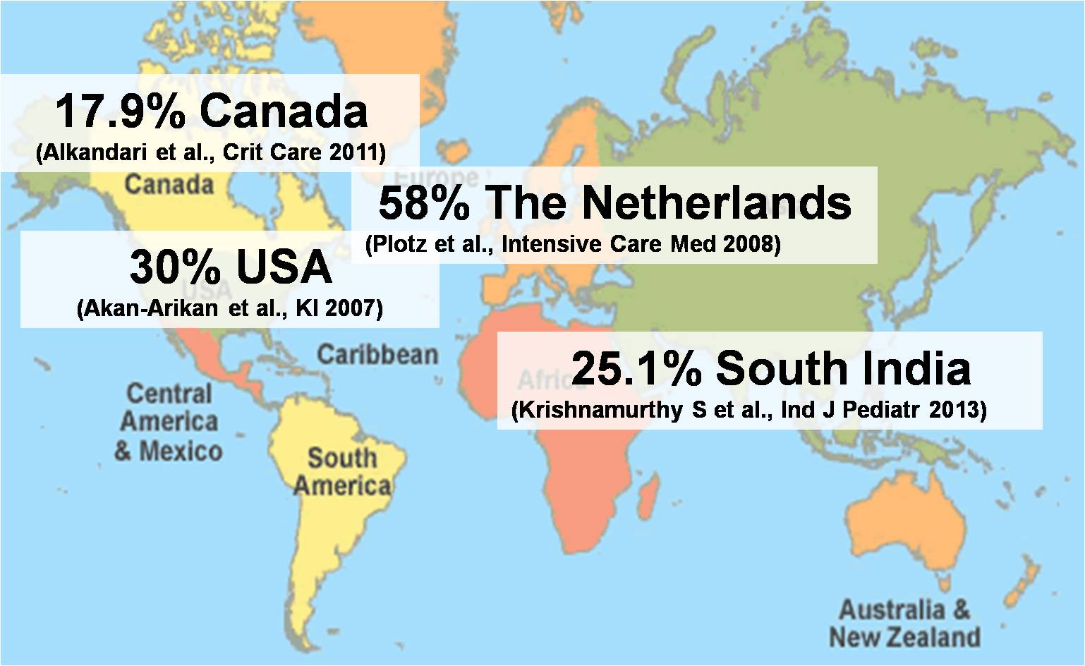
AKI Incidence: PICU
Courtesy of E. Vidal
Notes:
But even in developed countries, we can see how wide is the spectrum of AKI epidemiology throughout the world..

Slide 9
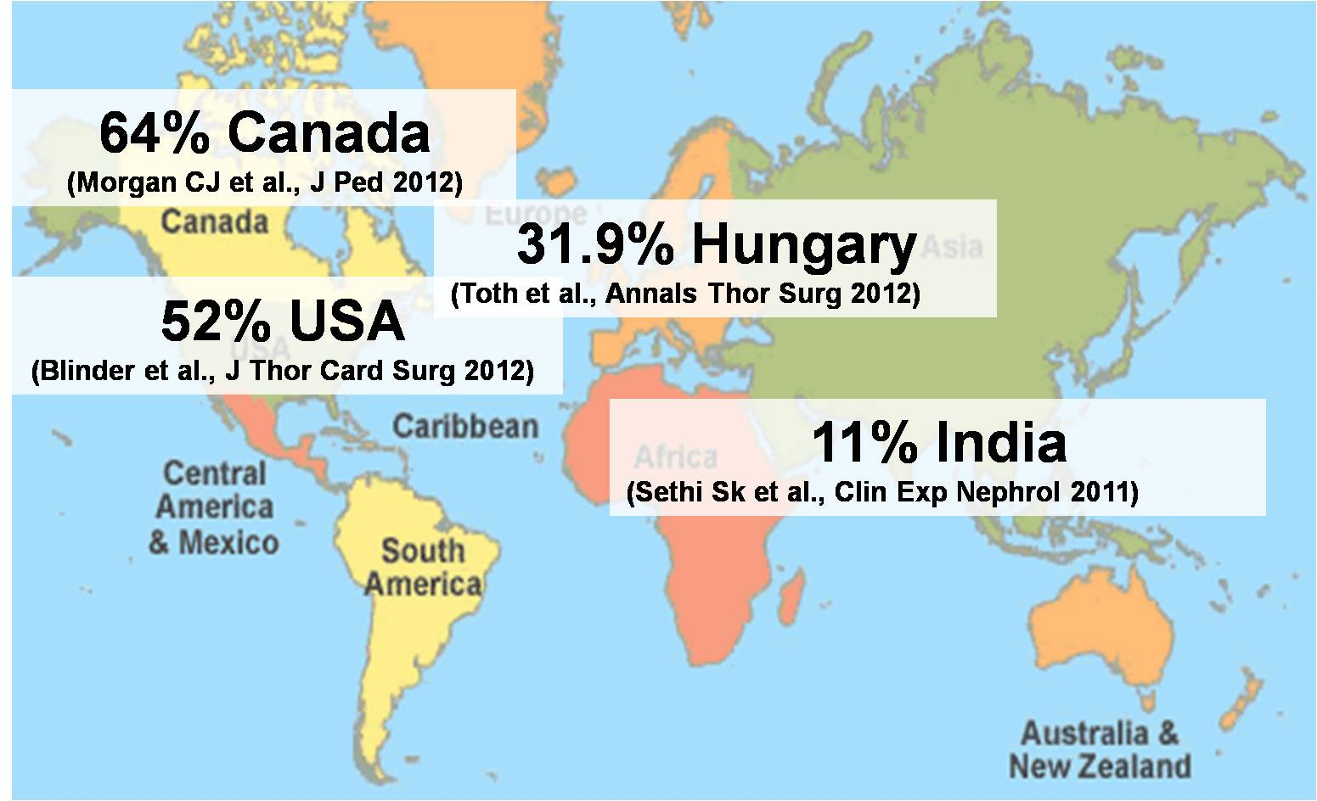
AKI Incidence: CICU
Courtesy of E. Vidal

Slide 10
FACTORS AFFECTING AKI EPIDEMIOLOGY INCIDENCE
AKI definition…
Complex treatments
(high morbidity)
Developed countries
Non-complex treatments
(low morbidity)
Local conditions
underestimation
Developing countries
Local diseases
(dehydration, malaria, envenomation, etc)

Slide 11
AKI IN CRITICAL CHILDREN : DEFINITION ISSUES

Slide 12
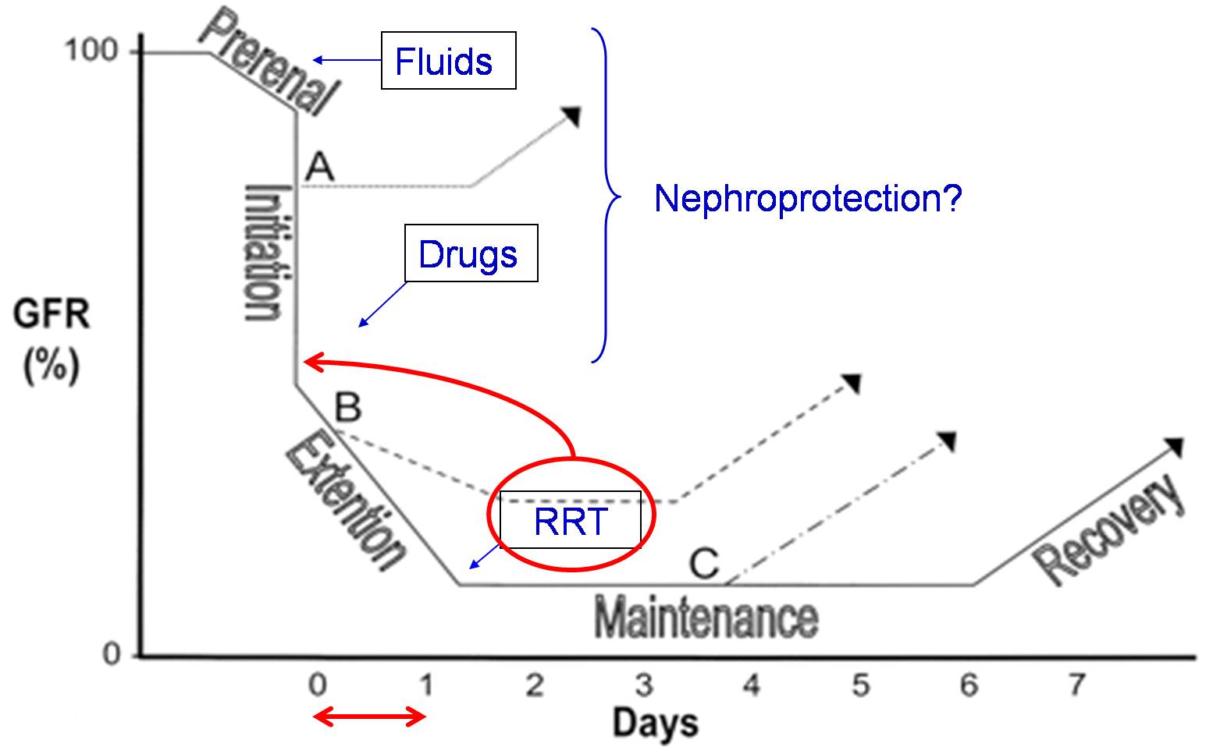
TIME WINDOWS FOR AKI MANAGEMENT
Modified from Sutton, 2002
Notes:
Basically, the importance of AKI definition relies on 2 issues: 1) AKI is now known to represent an independent predictor of mortality, 2) renal dysfunction comes to a head in the first 24 hrs from the injury, so that early diagnosis becomes crucial in order to establish an early treatment.

Slide 13
OVER THE YEARS…
sCreat or UO changes
Need for dialysis
pRIFLE
AKI definition
AKIN
KDIGO
Fluid Overload

Slide 14
pRIFLE
AKIN
KDIGO
Established AKI
High
Sensitivity
3
sCreat ↑↑↑
UO ↓↓↓
2
sCreat ↑↑
UO ↓↓
1
Initial
AKI
sCreat ↑
UO ↓
High
Specificity

Slide 15
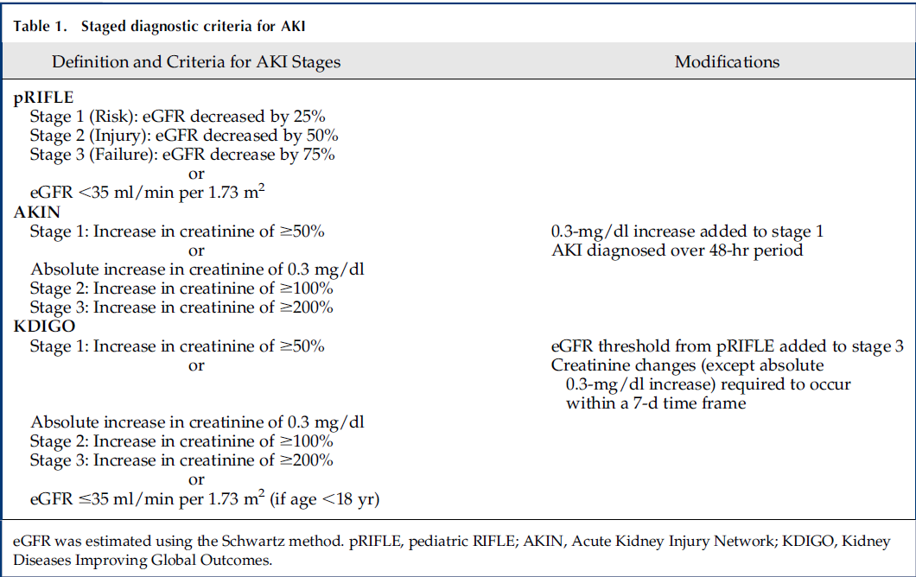

Slide 16
LIMITATIONS OF AKI CLASSIFICATION CRITERIA
pRIFLE
AKIN
KDIGO
inconsistency in application
urinary output criteria often excluded → loss of additional cases
exclusion of patients with elevated initial SCr
UO and sCr are late markers
Biomarkers…

Slide 17
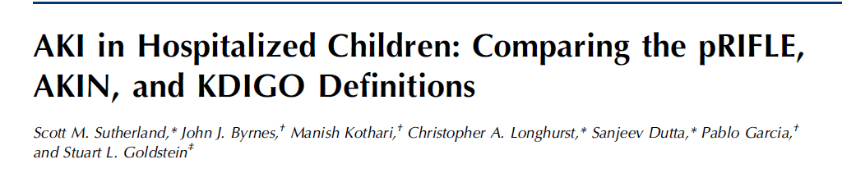
(1)
Methods :
29,181 hospitalizations (2006-2010)
188,032 serum creatinine values
Only sCr values used
ICU and non-ICU patients
Dependent variables: mortality, length of stay
Notes:
I would like to focus on this recent study. To my knowledge this is the first study the ultimate goal of which has been to integrate an automated AKI diagnostic tool into the electronic medical record…

Slide 18
(2)
Main Results:
Across all definitions:
Mortality and LOS higher in pts with all AKI stages
AKI severity associated with progressively higher
mortality in ICU pts (not in non-ICU pts)
Median LOS higher among hospitalizations with AKI

Slide 19
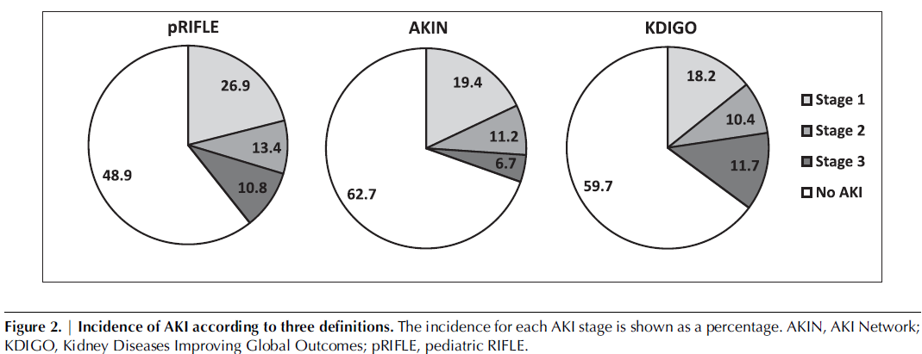
AKI diagnosis: pRIFLE 51%, AKIN 37.3%, KDIGO 40.3%

Slide 20
(3)
Conclusions:
disparities in staging between the three classifications
pRIFLE: most sensitive
AKIN: most selective
KDIGO: incidence between pRIFLE and AKIN (benefit of applying to both
children and adults)
“the necessity of a unified AKI definition is recommended…”

Slide 21
sCr or UO?
UO:
Pro:
Immediate response
Con:
Low UO may not reflect low GFR
sCr:
Pro:
Generally, more sensitive than UO
Con:
Needs blood sample
Low, variable muscle mass may affect sCr and not relate to GFR
In adults, studies utilizing both criteria showed higher AKI incidence
In children?

Slide 22
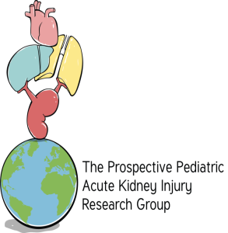
Assessment of Worldwide AKI, Renal Angina and Epidemiology in Children: The International AWARE Study
Stuart L. Goldstein, MD
On Behalf of the AWARE Investigators

Slide 23
Day | N (% total) | Nephrotoxins | Diuretics | Cumulative Fluid Balance | % FO | KDIGO 2-3 by Cr | KDIGO 2-3 by UOP
1 | 4730 (90.4) | 37.1% | 14.7% | 604 (200-1266) | 3.6 (1.1-6.8) | 7.8% | 2.4%
2 | 2937 (56.1) | 42.0% | 23.9% | 870 (289-1685) | 5.4 (1.6-10) | 10.1% | 1.9%
3 | 2085 (39.9) | 42.3% | 30.9% | 1050 (339-2042) | 6.3 (1.9-8.4) | 11.3% | 2.3%
4 | 1563 (29.9) | 39.4% | 35.6% | 1145 (353-2518) | 7.5 (2.1-14.6) | 14.0% | 2.8%
5 | 1225 (23.4) | 40.7% | 38.8% | 1299 (391-2502) | 8.7 (2.7-16.5) | 11.6% | 3.2%
6 | 985 (18.8) | 41.5% | 40.4% | 1454 (469-2794) | 10 (3.1-18.9) | 12.9% | 2.4%
7 | 837 (16.0) | 43.2% | 39.4% | 1581 (492-2843) | 11.1 (3.3-21.1) | 11.9% | 2.9%

Slide 24
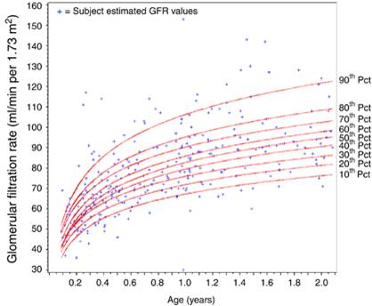
IN NEONATES
“Immature” newborn kidney
Low GFR
High Urine Output
(immaturity of tubular function)
To accomplish the physiologic extracellular post-natal fluid reduction (10% weight loss)
To manage the large water load coming from breast feeding
Torres de Melo Bezerra, NDT 2013

Slide 25
nRIFLE
Ricci, Ronco, adapted from Torres de Melo Bezerra, NDT 2013
Notes:
Torres de Melo

Slide 26
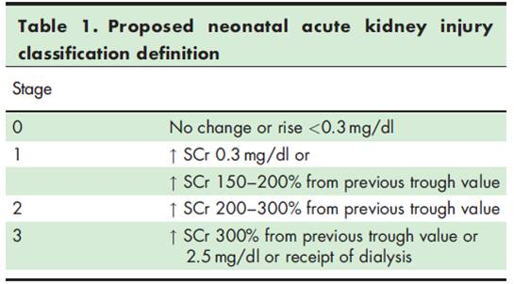
Jetton, Askenazi, adapted from Koralkar R, 2011

Slide 27
OVER THE YEARS…
pRIFLE
AKIN
KDIGO
PROPOSAL
STUDIES…
ROUTINE?
“the necessity of a unified AKI definition is recommended…”
Notes:
Over the years, these classifications passed basically through 3 stages…

Slide 28

ACKNOWLEDGEMENTS
All Dialysis Unit nurses
All PICU and CICU doctors and nurses
Tim Bunchman, Stu Goldstein and Claudio Ronco for precious advices and friendship through the years .

Slide 29
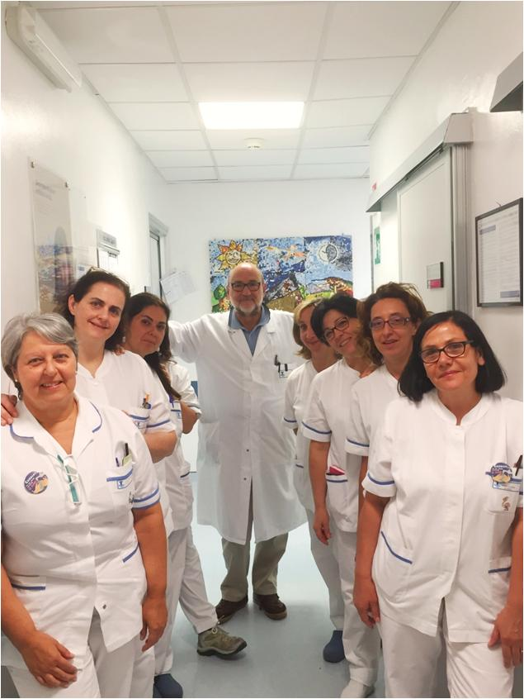
Dialysis Unit, “Bambino Gesù” Pediatric Hospital
Roma, Italy.
Doctor:
S. Picca
Headnurse:
V. Bandinu
Nurses:
N. Avari
D. Ciullo
E. Iacoella
P. Iovine
P. Lozzi
L. Stefani
Nurse Coordinator:
M. D’Agostino

Slide 31
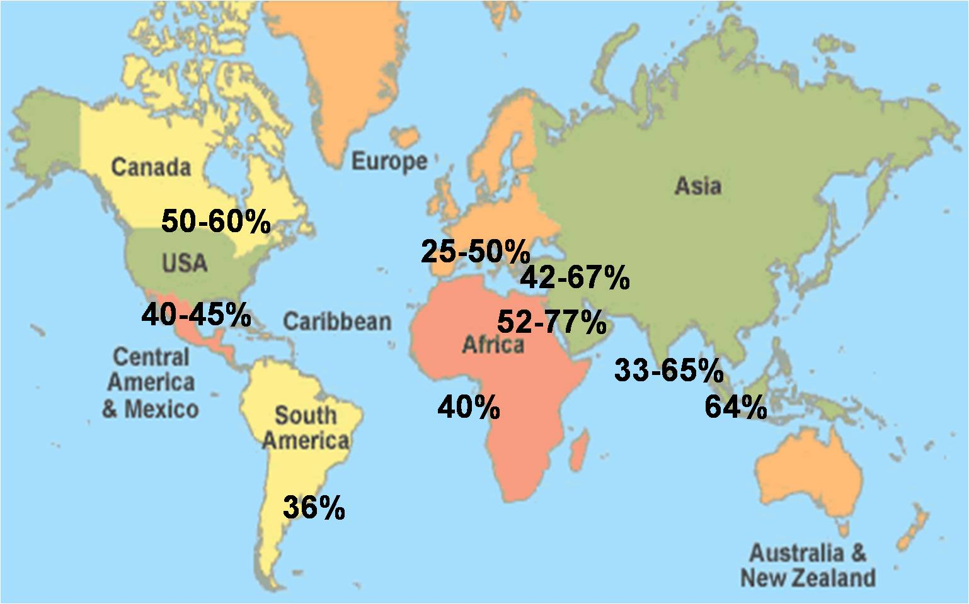
RRT-AKI Mortality high everywhere

Slide 32
AKI in children:
the dimension of the problem
10% of all children admitted in PICU suffer from varying degrees of AKI (Schneider, 2010)
AKI worsens mortality rates, increases duration of mechanical ventilation, prolongs hospital stays in critically ill children (Basu, 2011)
AKI carries a 50% mortality rate in children requiring CRRT (Symons, 2007)
Pediatric AKI survivors are at risk for progression to CKD (Askenazi, 2006)
AKI-associated mortality is not solely secondary to standard sequelae (e.g., hyperkalemia, acidosis, or uremia (cross-talk between the kidney and other vital organs) (Doi, 2011)

Slide 33
AKI RISK IDENTIFICATION AND MANAGEMENT
EASILY PREDICTABLE:
Heart surgery,
initial sepsis, BMT, LT,
nephrotoxicity, etc
HARDLY PREDICTABLE-
UNPREDICTABLE:
Late referral, ATN,
metabolic diseases , etc
Classification
most useful
Preventive interventions
possible
Classification
less useful
Quick interventions
needed
pRIFLE-AKIN
Limit fluid overload
(Late) RRT
diuretics
RENAL ANGINA ?
fenoldopam
Early RRT

