Slide 2
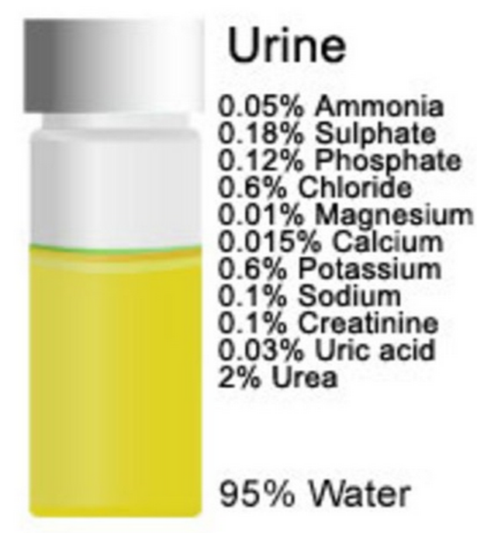
What are we trying to dialyse?
Fluid overload
Electrolyte balance (Na/K/Ca/Phos)
3) Acid base balance
4) Waste products (Urea / Ammonia)
5) Cytokines (sepsis)
6) Mystical blood purification

Slide 3
Reasons for dialysis in PICU?
Fluid overload
Electrolyte balance (Na/K/Ca/Phos)
3) Acid base balance
4) Waste products (Urea / Ammonia)
5) Cytokines (sepsis)
6) Mystical blood purification

Slide 4
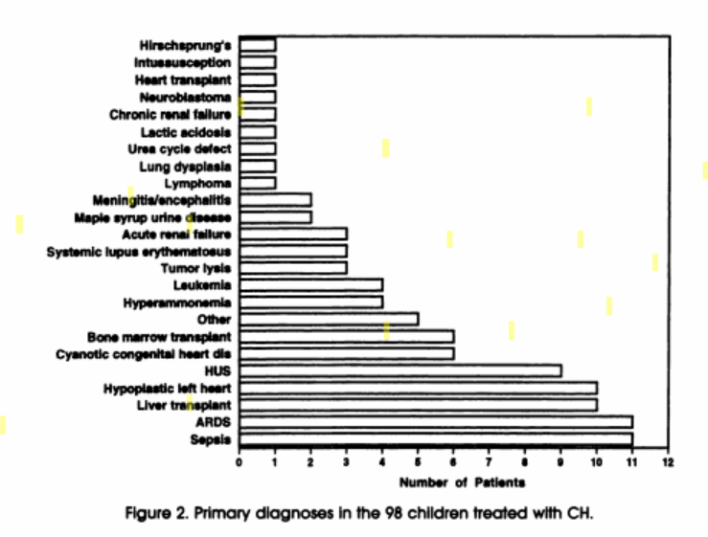
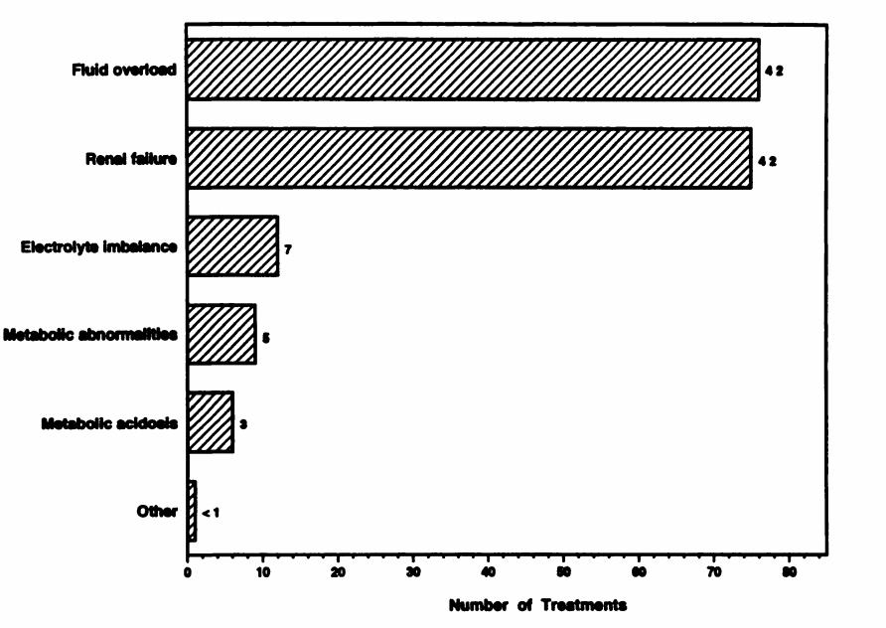
Fluid overload is the major problem?
Mainly Sepsis , ARDS andCardiac disease Fluid overload major factor

Slide 5
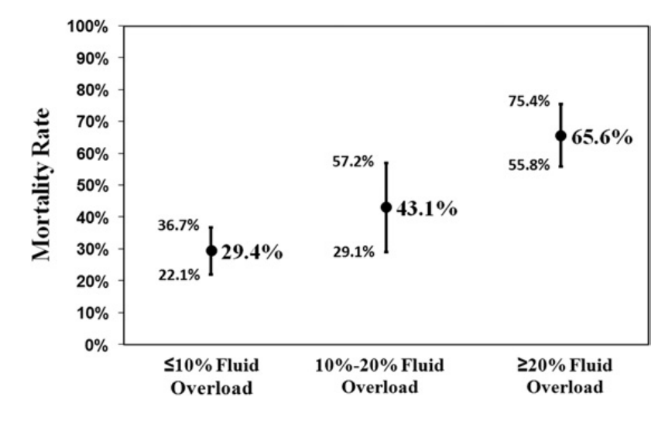
Fluid overload = mortality risk?
N=297 children
Multicentre
3% mortality per 1% increase fluid overload
Sepsis 25% 37% 40%

Slide 6
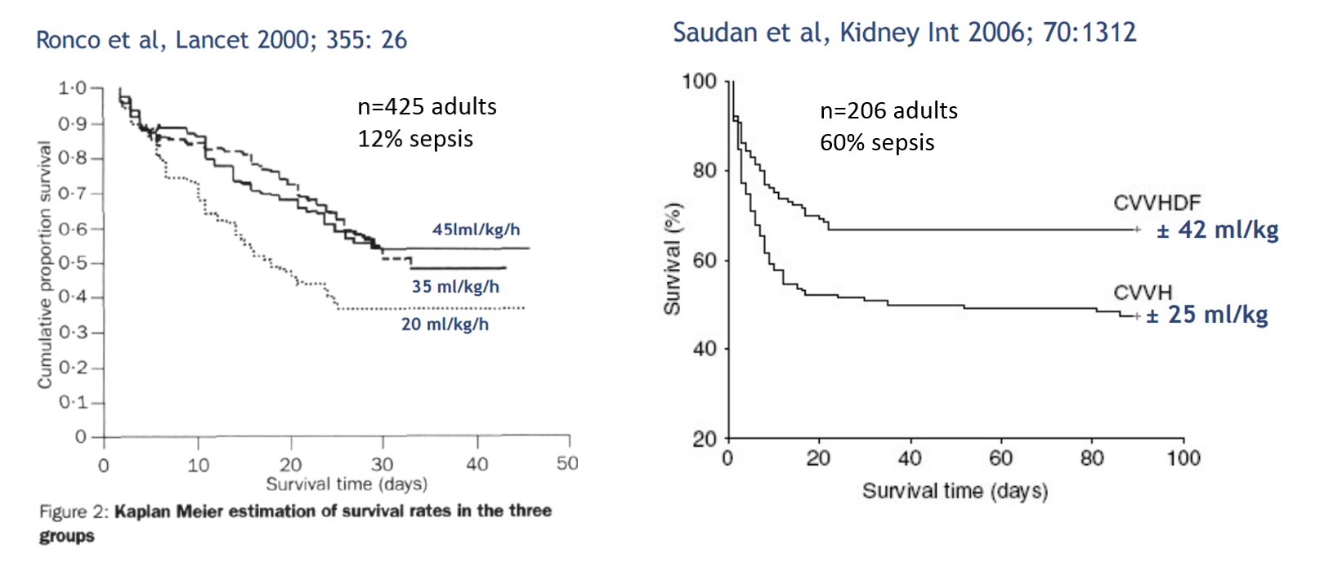
Bigger dialysis dose is better?

Slide 7
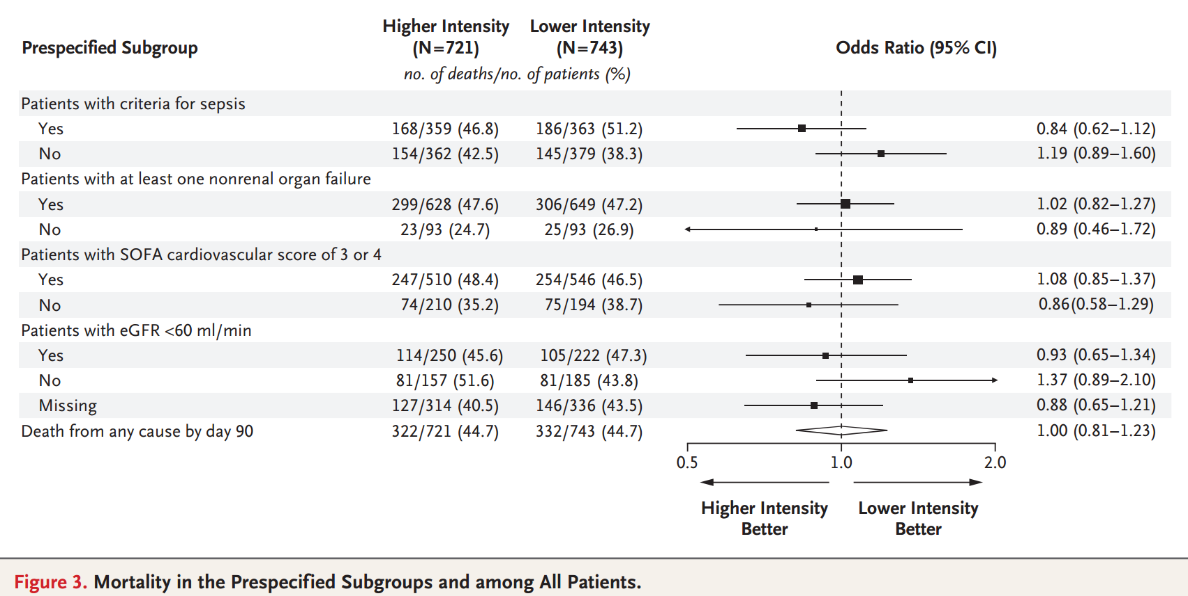
Bigger dialysis dose is better if sepsis?
RENAL STUDY (NEJM 2009) n= 1508 Adults 50% had sepsis (25 vs 40ml/kg/hr) No difference in survival
Target CVVH dose not always achieved (>12 to 16% of time)

Slide 8
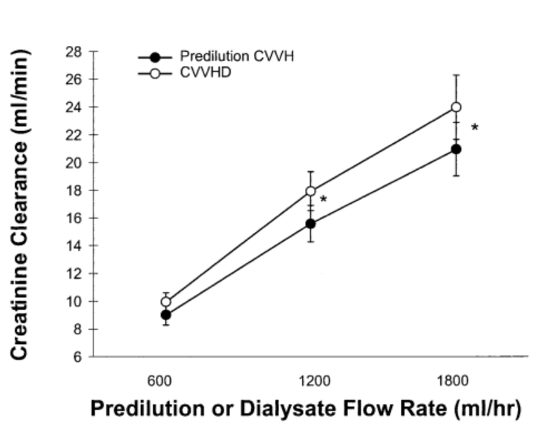
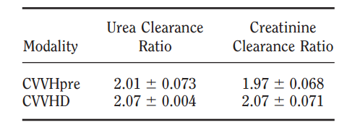
Dialysis mode vs dialysis dose?
Ratio of BFR 60ml/min vs 30 ml/min
The more you drive the filter,
The more you get off
Paed filter @ BFR 60ml/min
17% UFR of BFR

Slide 9
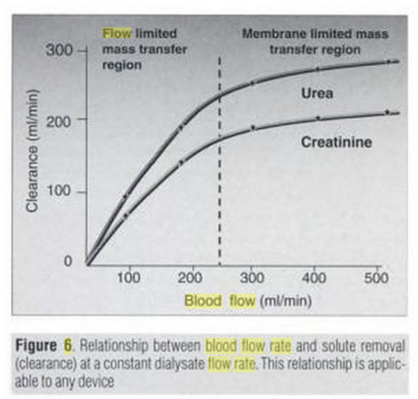
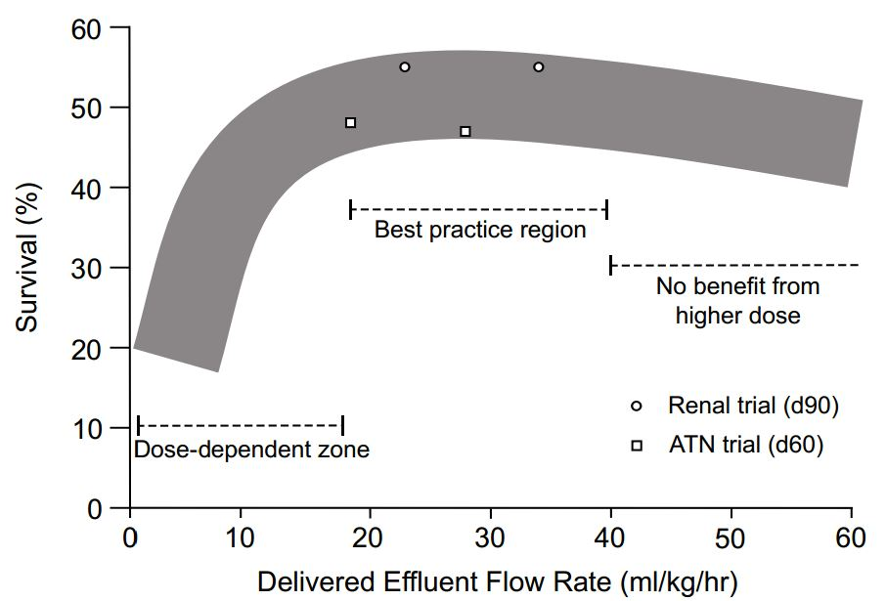
Adult CVVH vs Paediatric CVVH
BLOOD FLOW RATES IMPORTANT
TO MAXIMISE CVVH EFFICIENCY
2) FILTER PERFORMANCE AT LOW BFR
QUESTIONABLE
3) LIMITATIOJN OF ADEQUATE BFR
(patient size)
4) RECIRCUALATION RATE S IN CHILDREN
HIGH (smaller space)
Efficiency of CVVH in children
may be limiting factor

Slide 10
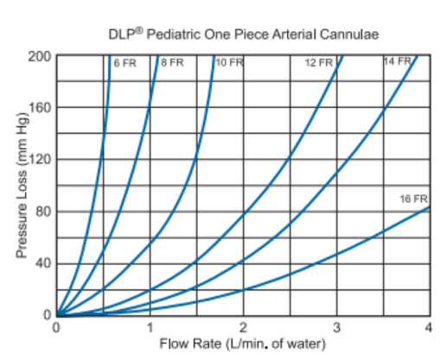
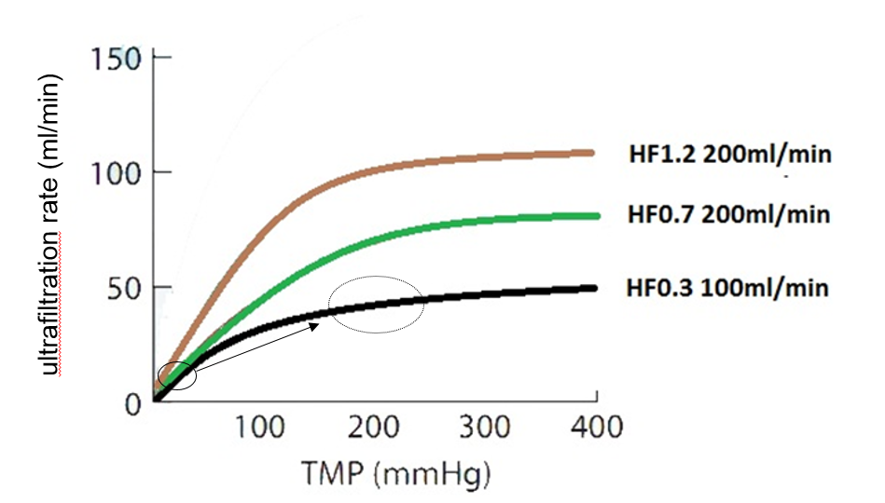
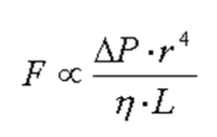
Blood flow rate issues in children: Efficacy
Blood flow rate dependence:
Getting most of filter performance
6 Fr = 2.0mm
12 Fr=4.0mm

Slide 11


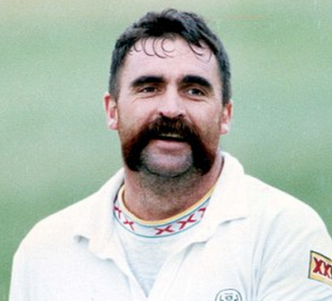
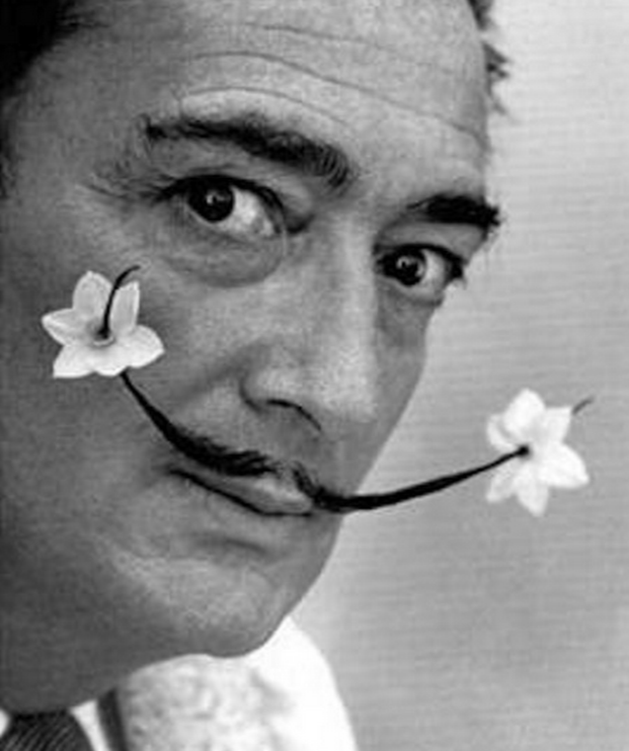
Why do things in small measures?
BIG IS BEST

Slide 12
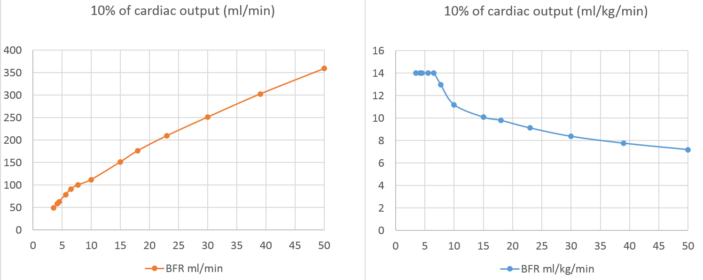
Adult CVVH BFR zone
10/kg/min
BFR ml/kg/min
BFR ml/min
5/kg/min
2/kg/min
Weight Weight

