Slide 1
Basics of CRRT Terminology
Dr Umut Selda Bayrakçı
Yıldırım Beyazıt University, Dept of Pediatric Nephrology, Ankara, Turkey

Slide 2
Terminology
everchanging array of names and abbreviations…
  lack of standardization…
  creates unnecessary confusion…
  prevents accurate comparisons and multicenter research
  and is scientifically undesirable…
Bellomo, Ronco, Mehta, AJKD,1996

Slide 3
Pub Med Search
  40/58 use the acronym CVVHD incorrectly
  15/40 incorrect definition in nephrology journals
  15/40 incorrect definition in IC journals
From Picca S, 6th International Conference on PCCRT, Rome,2010

Slide 4
CRRT NOMENCLATURE
PHYSICAL PRINCIPLE
TREATMENT DURATION
CONVECTION
(ultrafiltration)
DIFFUSION
(dialysis)
CONVECTION
+
DIFFUSION

Slide 5
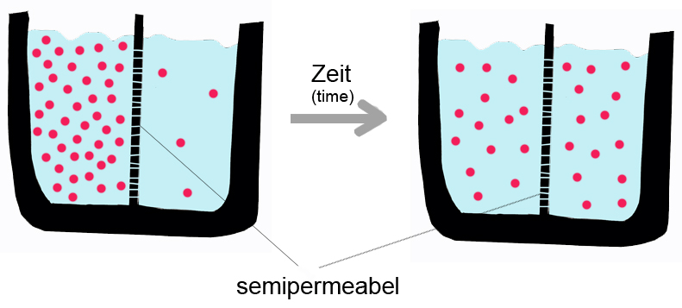
Solute transport mechanisms:
Diffusion
Solutes randomly move across the membrane from the more concentrated solution to the less concentrated one
Solutes in higher concentration will flow in the reverse
Finally the traffic across the membrane will be equal in both directions
Two solutions will be in equilibrium
Smaller molecules will tend to diffuse more easily

Slide 6
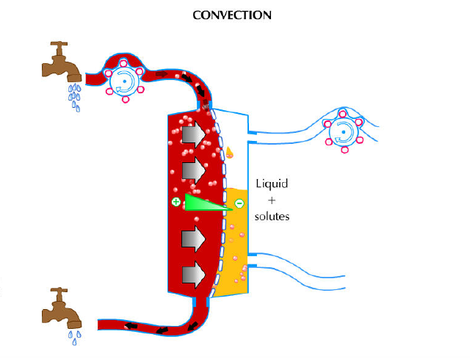
Solute transport mechanisms:
Convection
Movements of molecules across a semipermeable membrane due to a pressure gradient (rather than a concentration gradient as in diffusion)
Small and large molecules tend to pass across the membrane with equal efficiency (up to size limit of the membrane)

Slide 7
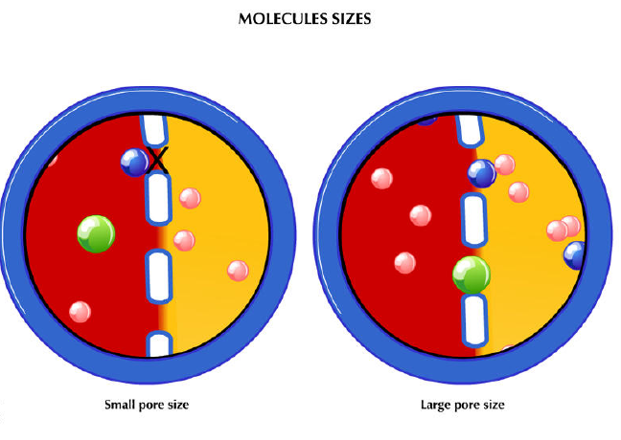
diffusion
convection

Slide 8
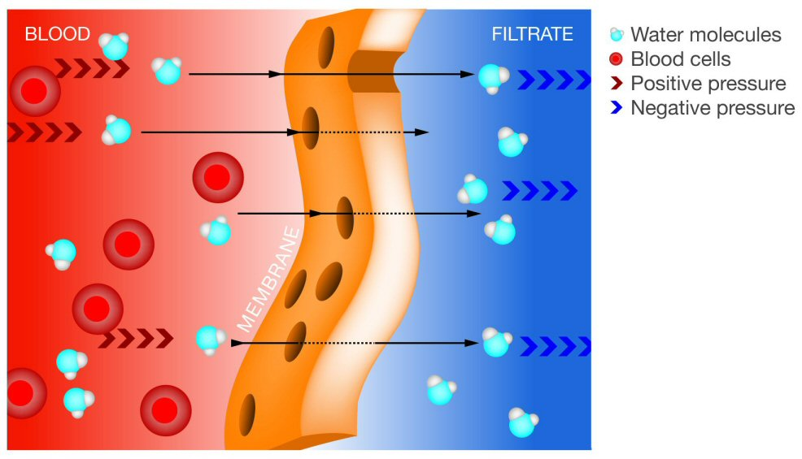
Ultrafiltration: Movement of water molecules across
a semipermeable membrane under the effects of pressure

Slide 9
Continuous renal replacement therapy
Originally proposed by Peter Kramer (1977) as a method of filtration by intraarterial catheters and known as CVAH (continuous arteriovenous hemofiltration)
Filtrate outputs provided by patients unstable blood pressure were soon found to be inadequate
(especially when the large amount of nitrogenous wastes associated with the hypercatabolic patient is considered)
Several technical modifications were developed:
  CAVHD: addition of a diffusive component for solute removal
  CVVH/CVVHD: continuous blood-pump filtration or dialysis
Notes:
CRRT has been applied to a variety of extracorporeal techniques for supporting critically ill patients with AKI.

Slide 10
Continuous renal replacement therapies
CAVH: Continuous ArterioVenous Hemofiltration
  Arterial access allows blood flow trough a tubing circuit low resistance hemofilter back to a venous access
  Filtrate rate is several hundred ml/h
  Continuous anticoagulation is administered through a prefilter tubing connection
CAVHD: Continuous ArterioVenous
HemoDiafiltration
  a diffusive component is added to enhance urea clerance

Slide 11
Continuous renal replacement therapies
SCUF: Slow Continuous UltraFiltration
  Blood pressure-driven ultrafiltration without replacement fluid
  Provide continuous, iso-osmotic fluid removal
  No solute removal (intermittent HD may be required for adequate solute removal)
  Useful as a means of maintaining fluid balance in patients intolerant to aggressive fluid removal

Slide 12
Continuous renal replacement therapies
CVVH: Continuous VenoVenous Hemofiltration
  Circuit requires a blood pump and an air detector
  Often equipped with arterial and venous pressure monitors
  Has the advantage of avoiding potential complications of arterial access
  Capable of providing a substantial amount of convection based clearance
  Blood flow rates between 100-150 ml/min decrease the tendency for filter clotting (limits the dosage requirements for anticoagulants)
CVVHD: Continuous VenoVenous HemoDiafiltration
  Resembles to CVVH
  Allows a variable amounts of dialysate to flow past the filtrate compartment of the filter

Slide 13
Free flow AV techniques have largely been abandoned in favor of pumped venovenous methods
Yield more consistent blood flow
minimize the bleeding from arterial access

Slide 14
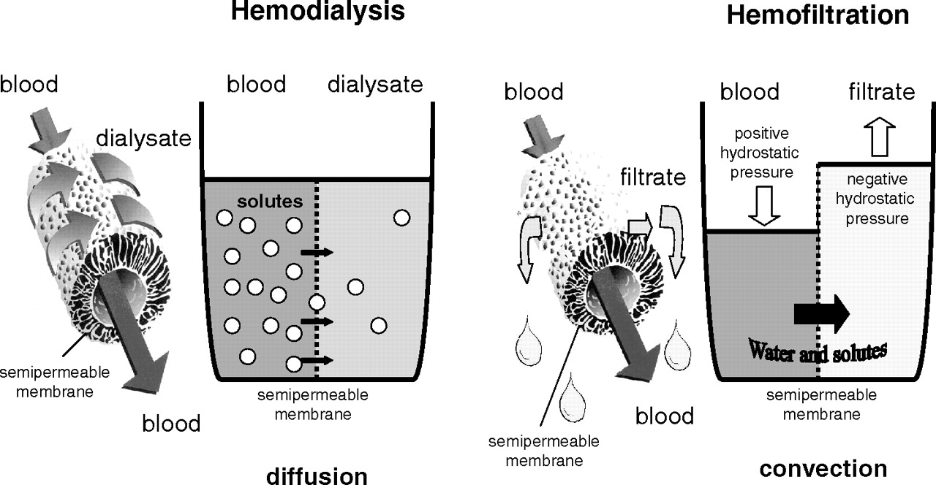

Slide 15
Infused fluids for CRRT
Dialysate:
  a variety of commercially prepared premixed solutions
  The solution utilized will depend on the metabolic status of the patient
Replacement fluid:
  Used to compensate for volume lost with high levels of convective clearance
  Commercially prepared replacement fluids
  Normal saline or lactated ringer
  Biochemical status of the patient should be considered

Slide 16
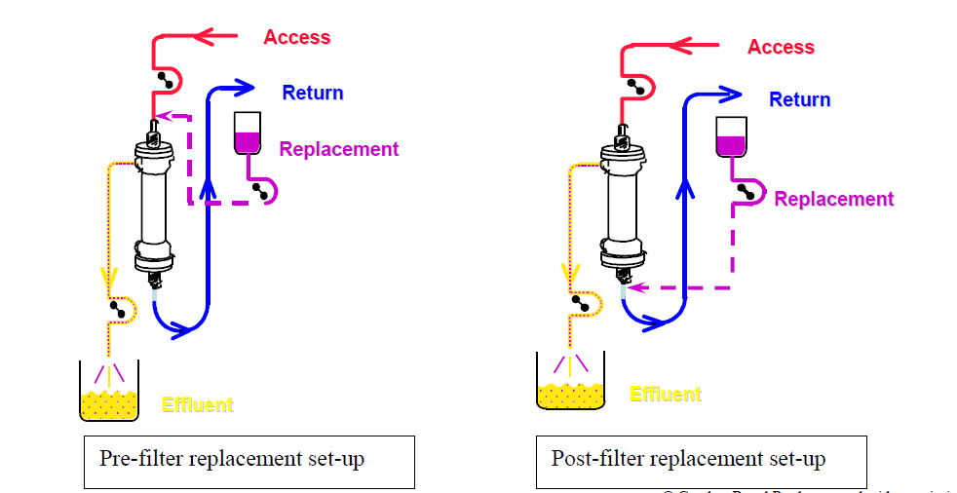
Replacement fluid
Notes:
Replacement fluid can be administered either premembrane filter (predilutional) or postmembrane filter (postdilutional)
16

Slide 17
Predilutional replacement
Postdilutional replacement
Preferred for venous-venous circuits
Theoretically it decreases the blood viscosity
Improve filter longevity
Decrease anticoagulant requirements
Preferred for arteriovenous circuits
May result in improved solute clearance
the optimal pre- and postdilution ratio for replacement fluid is suggested
to be 1/3–2/3 by some experts. Honore PM et al. Blood Purif 2009

Slide 18
Continuous renal replacement therapy modalities
CRRT MODALITY | Type of infused fluids |  | Form of molecular transfer
 | Dialysate | Replacement fluid | diffusion | Convection
SCUF |  |  |  | minimal
CVVH
CVVHD
CVVHDF

Slide 19
Circuit prime
In small children large volume circuit require priming with blood to prevent cardiovascular collapse during dialysis initiation
  When the extracorporeal volume exceeds 10-15% of patient’s blood volume
  If patient has severe anemia
  Profound hypotension
The circuit is filled with priming fluid and then attached to the patient, allowing the priming fluid to enter the circulation
Extracorporeal circuit is usually primed with
  a mix of packed red blood cell+ 5% albumin
  5% albumin alone
  0.9% sodium chloride

Slide 20
“Bradykinin release syndrome” often is observed with blood priming of AN-69 CRRT circuit membranes!
Manifested by acute hypotension with CRRT initiation
  Avoid use of AN-69 in nonsespsis situations
  Bypass the blood prime
  Normalize the pH of blood

Slide 21
High volume hemofiltration: Continuous high volume treatment of more then 50 ml/kg/h
  Honore PM et al, Blood purif 2009
Pulse HVHF: intermittent high-volume hemofiltration with brief, very high-volume treatment at 100 –120 ml/kg/h for a short period of 4 – 8 h, followed by conventional CVVH.
Ronco et al. Int J of Artif Organs 2004
In adults, claimed to be more efficient in mediator’s removal, hemodynamics and improvement of immune dysfunction ?
Notes:
High-volume hemofiltration is an extracorporeal therapy that has been available in the intensive care unit for more than 10 yr. Recent improvements in technology have made its clinical application easier and safer. However, the defini- tion, indications, and management of this technique are still unclear, and considerable controversy and confusion remain.

Slide 22

Mustafa Düzgünman

