Slide 1
PCRRT in ECMO
Norma Maxvold MD
Associate Professor of Pediatrics
Children’s Hospital of Richmond-VCU

Slide 2
PCRRT in ECMO
Objectives:
Review of CRRT Role in ECMO population
Understand the CRRT Filter Set-up with the ECMO System
Review Effectiveness of CRRT in the ECMO population

Slide 3
PCRRT in ECMO
Extracorporeal Membrane Oxygenation (ECMO)
Began in 1970’s , First in Neonatal g Pediatric g Adult
ELSO Registry now has ~ 90 US Centers, participate in Broad database Warehouse of ECMO support.
Length of support range of hours to weeks (longest ECMO run 117 days)
Indications
Cardiopulmonary Support not responding to other conventional therapies
Reversible underlying Process
Notes:
ECMO began in late 1970 ‘s and has expanded from initially a neonatal support to all age support platform.
Indications for ECMO can be for cardiac, pulmonary or both organ system needs while awaiting the primary process to reverse.

Slide 4
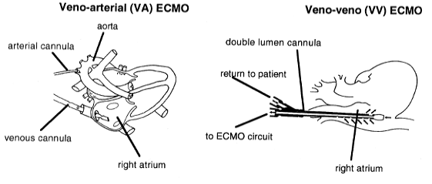
Notes:
The extracorporeal circuit can be through a venoarterial setup or a venous setup which can be through 2 venous cannulas or a double lumen cannula, which are now becoming more popular.

Slide 5
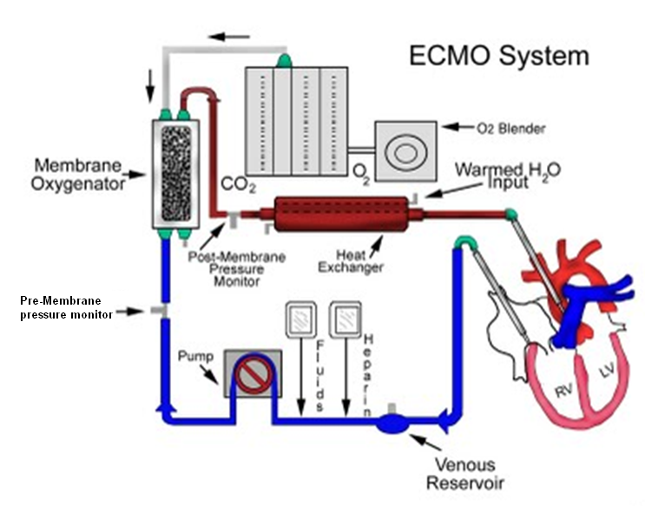
Notes:
This is a diagram of the overall system of VA setup on a child.

Slide 6
PCRRT in ECMO
Indications/Role of CRRT in ECMO:
Decrease fluid overload
Management of fluid balance to improve nutritional support
Removal of Inflammatory Mediators
Control of Electrolyte/Solute abnormalities
Decreased use of furosemide
Notes:
ECMO itself provides a support platform for hemodynamic and respiratory support of the patient but does not change alter existing injury present to the kidney, nor treat the underlying cause of the organ dysfunction. Therefore To support a child on ECMO with existing AKI or to address metabolic needs of the patient CRRT may be employed. Indications for adding CRRT to the ECMO circuit are as listed above.

Slide 7
Pathophysiology of AKI in ECMO:
Similar to General Critical Care
I.Vascular / Ischemic Injury:
a. Sepsis
b. Low Cardiac Output
c. Hypovolemia
II. Nephrotoxins:
a. Medications: NSAIDS,Antimicrobials,Chemotx
b. Endogenous: Rhabdomyolysis, Tumor Lysis,Hemolysis
c. Contrast dyes
III. Miscellaneous:
a. CardioPulmonary Bypass
b. Acute Compartment Syndrome
c. Other
Notes:
Etiology of AKI in ECMO patients are not significantly different from that of the general ICU patient. Often the primary cause being via ischemia or other stressors the kidney was exposed to prior to ECMO deployment.
Uchino et al JAMA 2005;294:813-818 AKI in ICU pts found the first 4 and major surgery to be most common triggers of AKI pathophys.
Other causes, hepatorenal, ,trauma. Ingestions

Slide 8
PCRRT in ECMO
Incidence of AKI in ECMO population:
Single centers ≈ 70-85%
Breakout groups:
Neonates with CDH 71% Criteria:
Gadepalli SK et al J Pediatr Surg 2011;46:630-635 RIFLE
Pediatric Cardiac 71%
Smith AH et al ASAIO J 2009;55(4):412-416 FO, Electrolyte Disorder,
GFR<35ml/min/1.73m2
Adults Post Cardiotomy 78%
Lin CY et al Nephrol Dial Transplant 2006;21:2867-2873 RIFLE
Adults Post Cardiotomy 81-85%
Yan X et al Eur J Cardiothorac Surg 2010;37:334-338 RIFLE , AKIN
Notes:
What is the incidence of AKI in the ECMO population ? Large multicentered collectively data is scarce, but individual centers have reported their experiences as above. A challenge in the past has stemmed from defining AKI similarly, most of the above centers used the RIFLE nomenclature (R=1.5 baseline Cr; I =2 x Cr ; F=3 x Cr; Loss; Endstage.
Gadepalli reported UMICH experience over a 10 yr period(1999-2009 N= 68 ECMO pt with CDH)
_Smith reported at Vanderbilt a 24 month period with N=49 ped cardiac ECMO runs and 71.7% met AKI criteria with 58.7% receiving CRRT.
Lin CY et al,Taiwan review over 24 month (2002-4) of adult CV pts where N=46 ECMO support and 78% met AKI (R,I,F) and 34.8 % required CRRT.
Yan X et al Eur J Cardiothorac Surg 2010;37:334-338 at Bejing reviewed a 4 yr period (2004-8,) N=67 found AKI of 81% RIFLE and 85% AKIN in the first 48 hr of ECMO, with 45 % RRT use in these patients.

Slide 9
PCRRT in ECMO
Use of RRT in ECMO population:
Single centers Data
Breakout groups: AKI% CRRT%
Neonates with CDH 71% 16%
Gadepalli SK et al J Pediatr Surg 2011;46:630-635
Pediatric Cardiac 71% 59%
Smith AH et al ASAIO J 2009;55(4):412-416
Adults Post Cardiotomy 78% 35%
Lin CY et al Nephrol Dial Transplant 2006;21:2867-2873
Adults Post Cardiotomy 81-85% 45%
Yan X et al Eur J Cardiothorac Surg 2010;37:334-338
Ped Respiratory 38% 30%
Hoover NG et al Intensive Care Med 2008;34:2247
Notes:
Use of RRT for these ECMO patients with AKI at these center ranged from 16~60 %.
(Gad= U Mich; Smith = Vandebilt; Lin = Taiwan; Yan = China; Hoover = Atlanta Engleston,) From the above data, it is clear that not all ECMO centers use CRRT to suopport their patients with AKI, a wide variance of this therapy in ECMO is seen. With relatively low use of RRT in the Neonatal CDH group with renal injury to a high use of CRRT ~60% at Vanderbilt in the post cardiac children where the AKI incidence ( RIFLE criteria) on ECMO was similar at 71%. What then are the reasons CRRT is performed in tadem with ECMO

Slide 10
ELSO Registry Data: 1998-2008
Population: AKI: RRT: Both: Neither:
Neonatal (7941) 3% 18% 5% 74%
Pediatric (1962) 4% 26% 16% 54%
Adult (1011) 7% 15% 27% 51%
(Non-cardiac)
Askenazi et al Pediatric CCM 2011
Notes:
Askenazi published in PCCM 2011 ELSO data over a 10 year period listing both AKI and RRT support. Difficulties again with the definition of AKI by the different centers as well as limited demopgraphic data including the length of preexisting renal dysfunction. Was not available.

Slide 11
PCRRT in ECMO
Fleming GM, et al. ASAIO J 2012. 58(4):407-14
Survey of ELSO Centers
Fluid overload (43%)
Prevention of fluid overload (16%)
AKI (35%)
Electrolyte abnormalities (4%)
Notes:
A recent report by Fleming evaluating collective data from surveying multiple (65) ECMO centers found Fluid Overload as the primary indication for CRRT (43%) and to prevent FO CRRT was begun in an additional 16%. AKI as the indication for CRRT was 35%Tand was primarily in the cardiac dominate ECMO centers. This Survey also found that in the primary modality was convective with CVVJ representing 43.4% of the CRRT and SCUF primarily done with a hemofilter in line and CVVH primarily done by a CRRTMachine in tandem.( method of support interface with the ECMO circuit)
the prescribing practice for the dialysis prescription was 63% by Nephrologist, 33% by intensivists and 4% dual authorship..

Slide 12
PCRRT in ECMO
Fluid used in Early Goal directed Therapy
to restore perfusion is GOOD!!
Key Component to the Sepsis Bundle Initiative
Prolonged Accumulation of Fluid during Critical Illness NOT GOOD!
FO studies : Independent Mortality Risk Factor
Is it the Fluid Overload itself or the Severity of Capillary Leak Process resulting in the FO????
Notes:
Clearly a preeminent focus in managing critically ill patients is to attempt to maintain fluid balance. Often during the immediate decompensation fluid must be used for intravascular support, yet there continues to be a growing body of literature that identifies degree of fluid overload an independent risk for mortality.

Slide 13
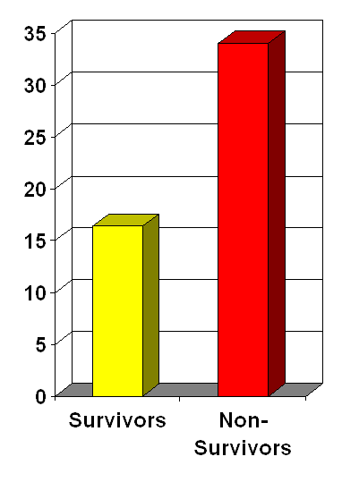
PCRRT in ECMO
Goldstein SL, et al: Pediatrics 107:1309-1312, 2001
Texas Children’s Hospital
21 pediatric ARF patients
Survival benefit remains even after adjusted for PRISM scores
FO%
Notes:
One of the First papers hilighting this association of FO and Mortality risk was Dr Goldstein’s in 2001 , where …

Slide 14
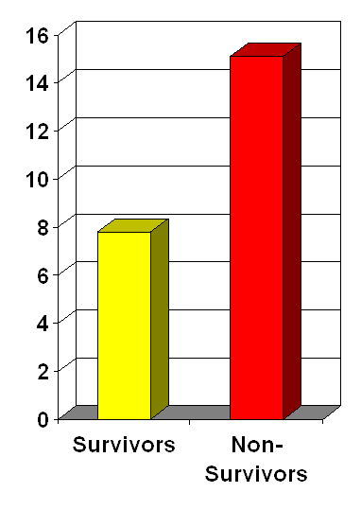
Foland JA, Fortenberry et al. Crit Care Med, 2004
Children’s Healthcare of Atlanta at Egleston
113 pediatric patients on CVVH
Multivariate analysis
Percent fluid overload independently associated with survival in ≥ 3 organ MODS
FO%
Notes:
Subsequent studies corobboratedthis FO association with Mortality have since been done , Foland and associates reviewing their 113 CVVH cases and examined the % FO prior to initiating the CRRT ( FO summarative calcs were made up to a week maximum of I&O prior to the CRRT). FO was defined as total fluid intake minus total fluid output divided by the body weight. Children with 3 or more Organ system dysfunction had % FO independently associated with decreased survival. The overall survival in this group children requiring CRRT was 61%, with median % fluid Overload of 7.8 % in the survivors ane median FO% of 15.1% in nonsurvivors .

Slide 15
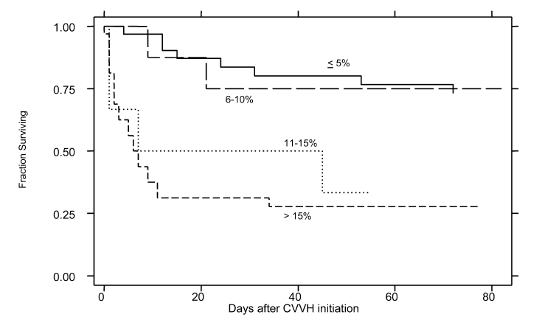
Gillespie RS, et al. Pediatr Nephrol 19:1394-1399, 2004
Seattle Children’s Hospital
77 pediatric patients
If pre-CRRT percent fluid overload >10%
3.02 times greater risk of mortality (95% CI 1.5-6.1, p=0.002)
Notes:
Gillespie also from Seattle demonstrated a similar %FO breakpoint of 10% at start of CRRT initiation to be associated with a 3.02 times greater risk of death.

Slide 16
PCRRT in ECMO
Fluid Overload in ECMO Population:
UMich ECMO Database (7/06-9/10)
53 Pediatric Patient on ECMO+CRRT
Survival 18/53(34%)
Survivors Nonsurvivors
FO Initiation CRRT 24.5% 38%
FO Discontinued CRRT 7.1% 17.5%
Selewski DT, et al Crit Care Med 2012
Notes:
Does this %FO at start of CRRT for the ECMO population display the same associated risk of Mortality? In a recent review of the Michigan ECMO Database the FO% at the start of CRRT was significantly lower in survivors (median 24.5%) than nonsurvivors (38%) and in the ECMO patients that had <10% FO at start of CRRT the best survival was seen (55.6% =5/9). These finding support earlier use of CRRT prior to large %FO.

Slide 17
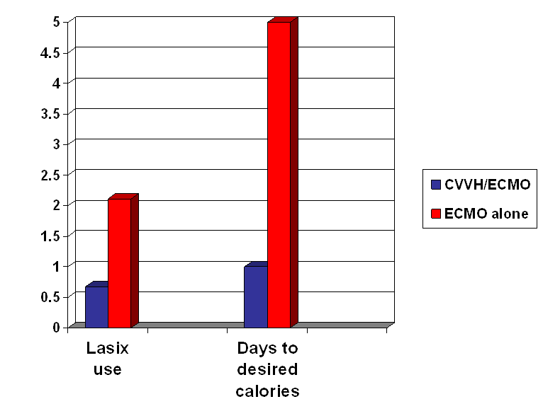
PCRRT in ECMO
Hoover et al Intensive Care Med 2008; 34:2241-2247
Notes:
In addition to achieving Fluid Balance when CRRT was employed during ECMO a decrease use of Furosemide from 2 mg/kg/d to 0.6 mg/kg/d was attainable, (furosemide dose being associated in adults with worse outcomes) and the capacity to reach full nutritional support(desired caloric prescription) within 1 day when on CRRT vs 5 days without CRRT.

Slide 18
PCRRT in ECMO
Renal Recovery after ECMO and CRRT:
Meyer RJ et al, Pediatr Crit Care Med 2001
U Mich ECMO Database (1990-1999)
35 neonatal /children on ECMO + CVVH
15 survivors (43%)
Renal Recovery in 14/15 (93%)
Paden et al, CCM 2007
Egleston ECMO Database (11/97-12/05)
95 neonatal /children on ECMO + CVVH
55 survivors (57%)
Renal recovery in 53/55 (96%)
Cavagnaro et al, Int J Artif Organs 2007
Santiago Chile ECMO database (5/03-5/05)
6 Infants on ECMO+CRRT
5 Survivors (83%)
Renal Recovery in 5/5 (100%)
Notes:
SO what do we know of the Patients receiving CRRT and ECMO? Knowing that in critically ill patients AKI is an independent risk of mortality, single centers have reported their findings in their ECMO population: with survival ranging from 43% to 83 % .
Cavagnaro study (12 neonates and Pediatric pt on ECMO, 6 of these also on CRRT.

Slide 19
Pediatric CRRT and ECMO
Mortality : AKI RRT Survival: AKI RRT
Neonate 27.4% 19% 39.7% 72.6 % 3.9% 16%
(7941)
Pediatric 41.6% 32.3% 58.9% 58.4% 12% 30.8%
(1962)
Mortality Odds Ratio AKI RRT
Neonates 3.2 1.9
Pediatric 1.7 2.5
Askenazi et al Pediatric CCM 2011
Notes:
Askenazi reported from the 10 year review of ELSO data a Mortality odds ratio for neonates on ECMO with AKI of 3.2 and for children 1.7, and likewise RRT use associated with a mortality odds ratio of 1.9 for neonate and 2.5 for children. AKI and need for RRT are clearly independent mortality.risks. Remembering Selewski report of degree of FO at start of RRT for the ECMO patient and it’s correlation to mortality, this might be a tool for earlier institution of RRT in these critically ill children, what effect thismay have on changing the mortality odd ratio is yet to be defined.

Slide 20
PCRRT in ECMO
Two modes of Interface for CRRT:
1.Use of inline hemofilter with IV/syringe pumps
2. Tandem stand-alone CRRT devices in parallel
Potential error rate noted with excess fluid removal over “expected” both for inline device and commercial device
Notes:
SO how do we actual perform or connect the CRRT filter/machine to interface with the ECMO circuit. There are 2 main approaches: The original method prior to stand alone CRRT machines were in-line filters and with the development of CRRT machine then these machine placed in parallel could provide additional dialytic clearance options.

Slide 21
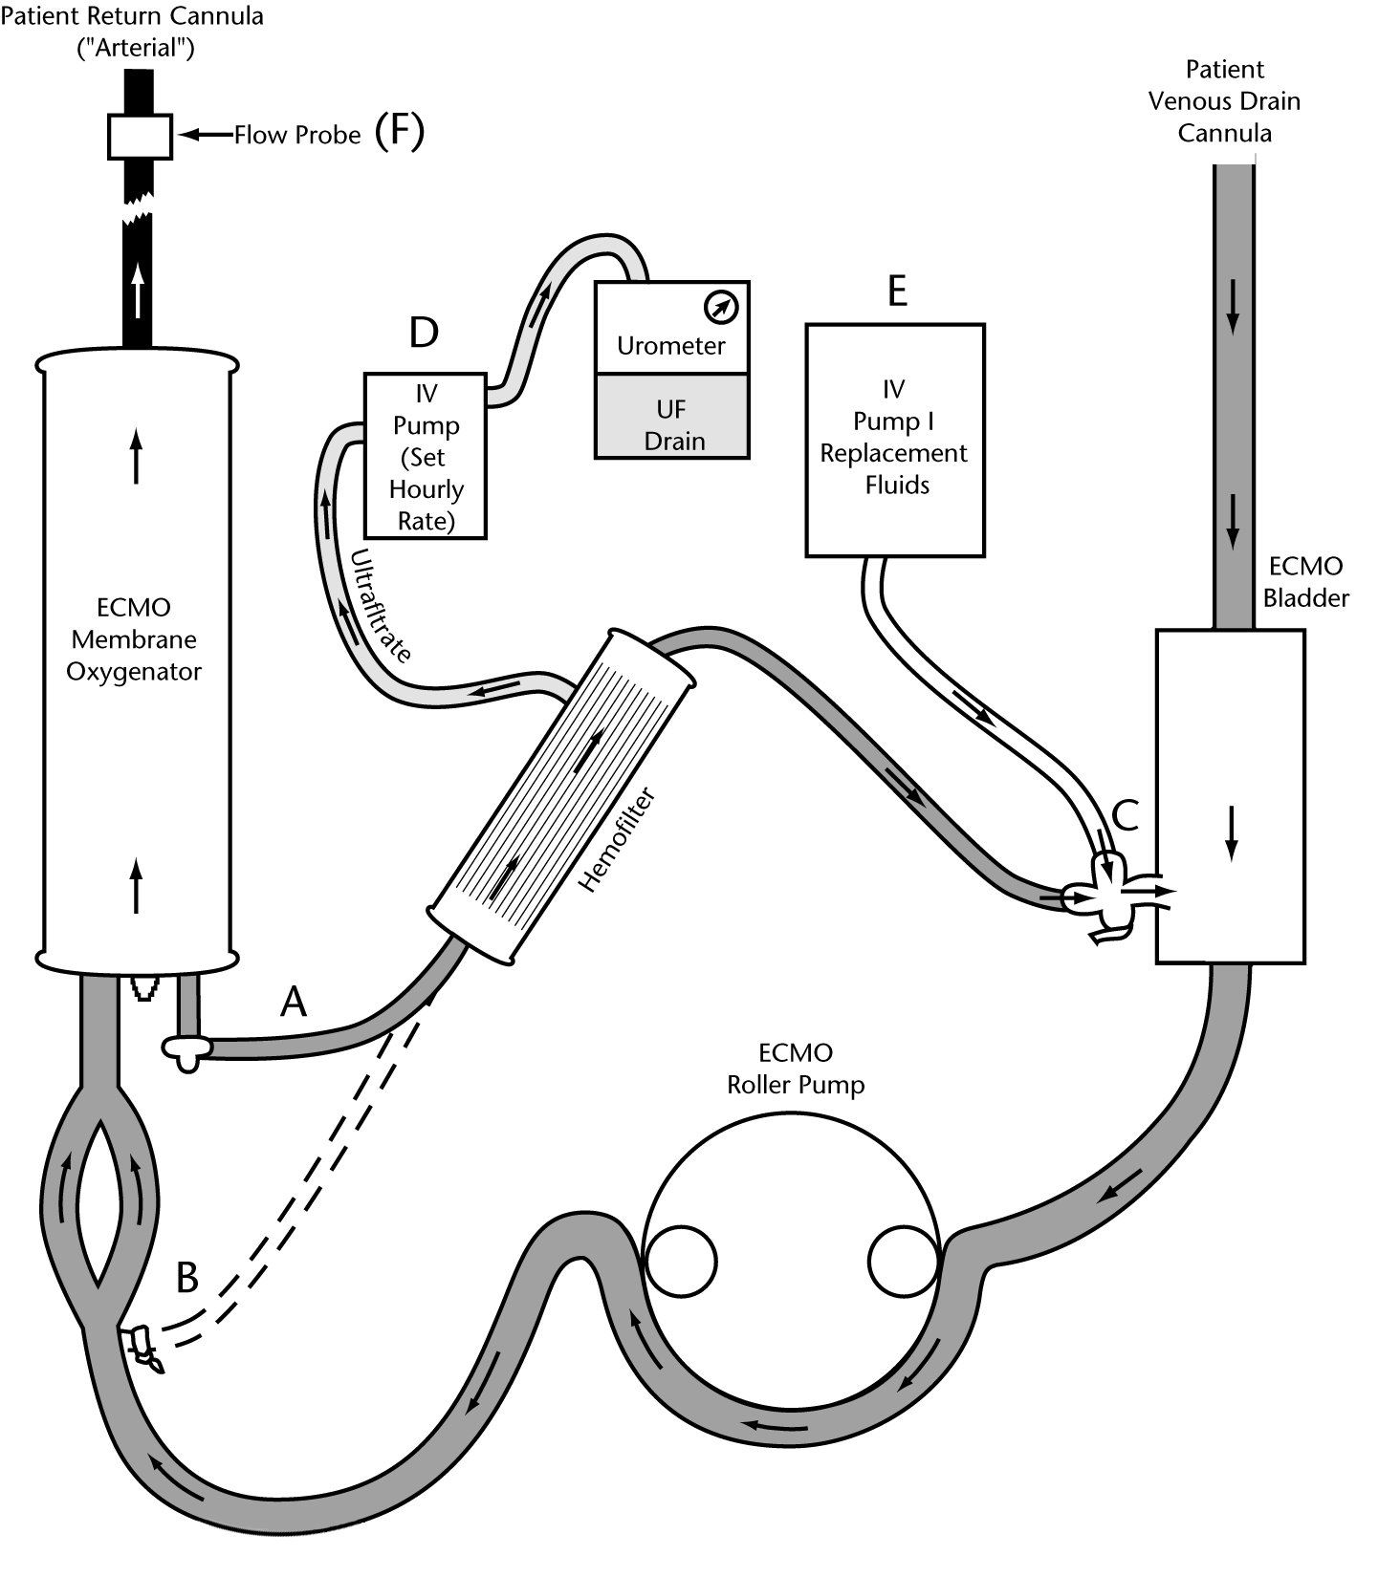
PCRRT in ECMO
POSITIVE
VENOUS
PRESSURE
Notes:
This represents the standard in-line filter setup, when only the hemofilter itself is used. In this cartoon of the ECMO circuit the pump is a roller ( positive pressure) generator. In this set up IV pumps are used to control the UF rate and this error rate up to 12% has been documented in the past for this type of system., hence the development of CRRT machines.

Slide 22
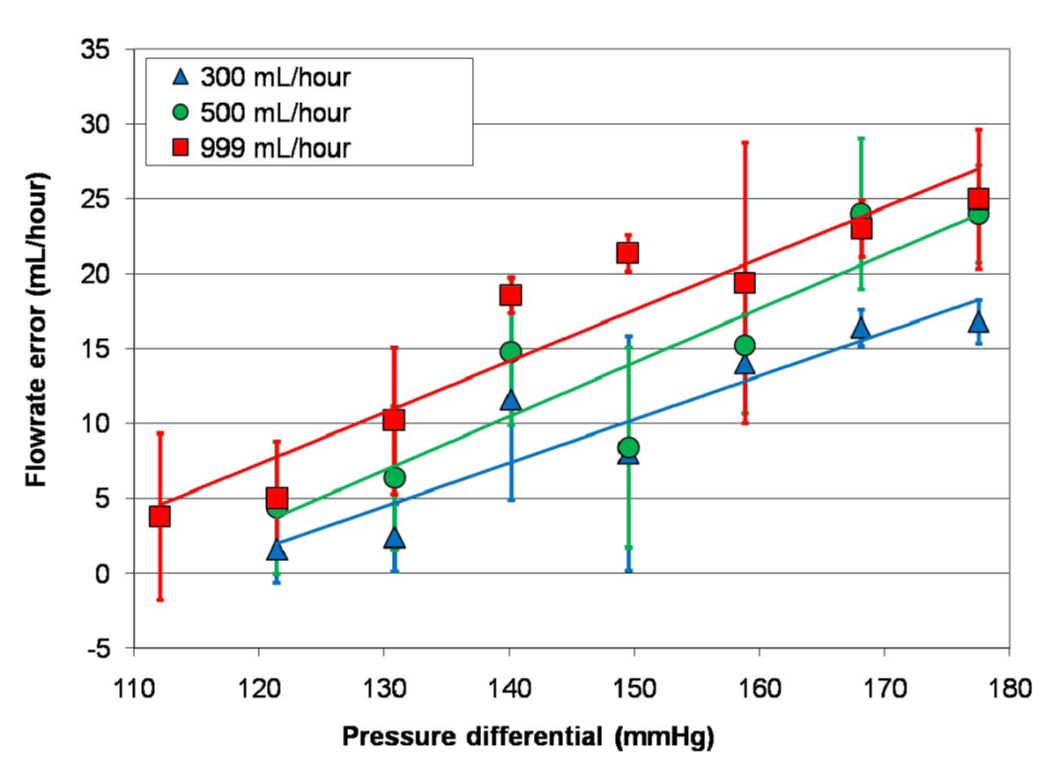
PCRRT in ECMO
CRRT Error Rate Increases with Increasing Flow/Pressure Sucosky, Paden et al., JMD, in press 2008
Notes:
The risk of UF removal errors increase as flow/pressure increases across the hemofilter .
Sucosky, Paden et al., JMD, in press 2008 demonstrate increase error in UF rates with increasing flow or pressure across the hemofilter membrane.

Slide 23
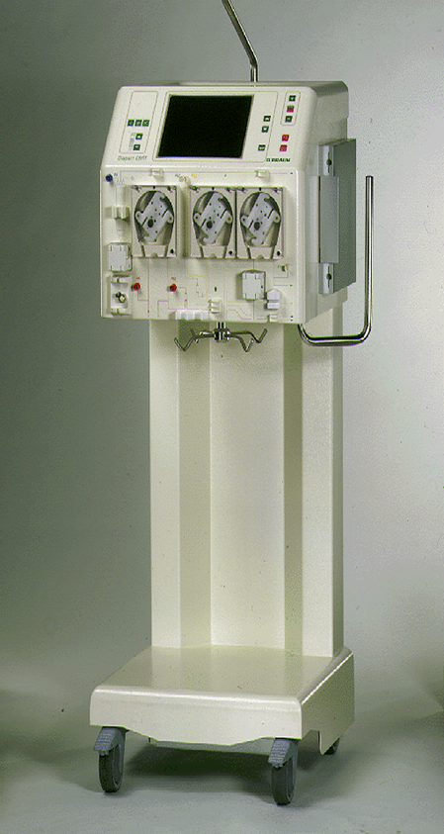
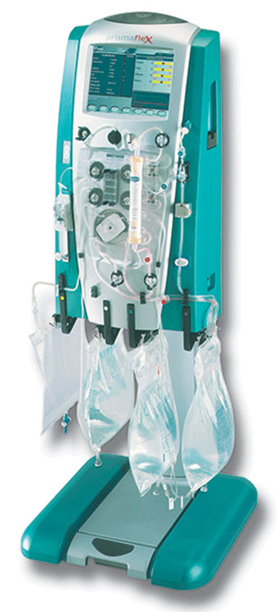
PCRRT in ECMO
Extracorporeal Blood Volume= Oxygenator+Pump System+ CRRT
Notes:
These are two stand alone CRRT machines. Theis extracorporeal volume now is additive to the ECMO circuit volume.

Slide 24
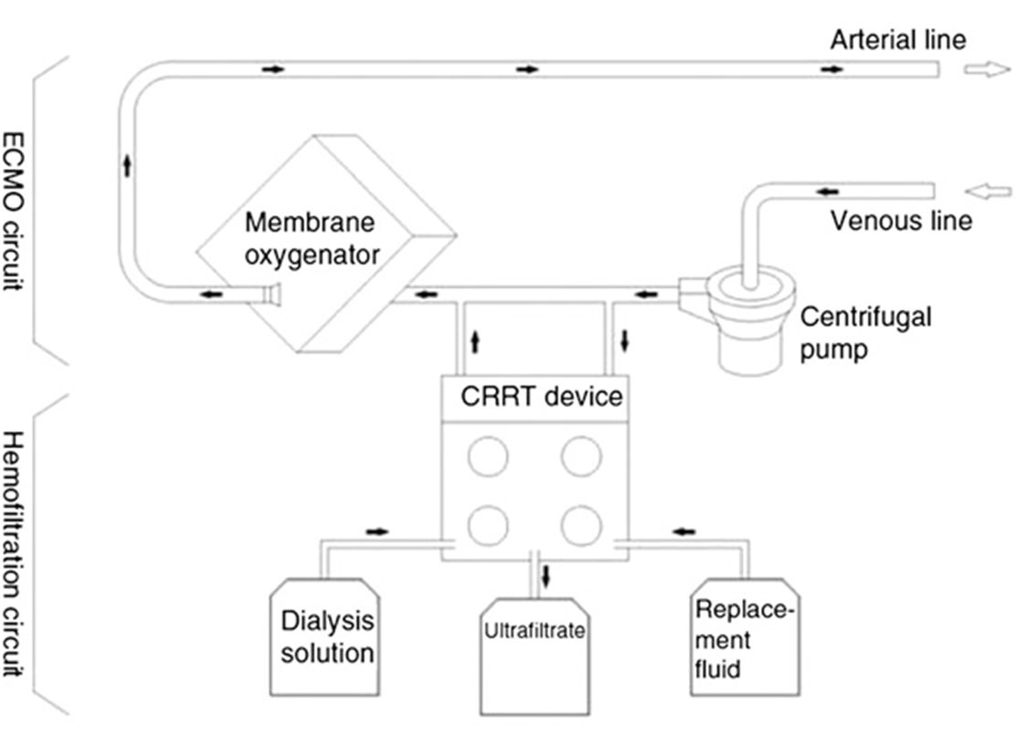
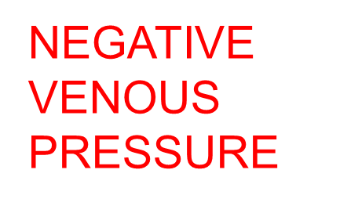
PCRRT in ECMO
Notes:
This cartoon is a schematic of the ECMO and CRRT in tandem circuit, with the more commonly used centrifugal pump that creates a negative venous pressure flow. When setting up the RRT and ECMO depending on your CRRT Extracorporeal system volume, and that ratio to the patient intravacular volume, priming with Blood for the small patient may be needed.

Slide 25
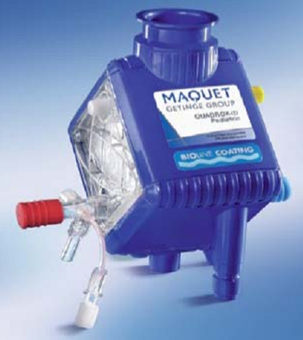
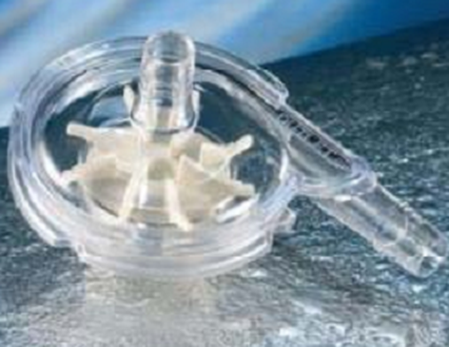
PCRRT in ECMO
PMP Oxygenators
Smaller prime volume
Shorter blood path
Less pressure drop across the membrane
Centrifugal pumps
New levitating impeller based designs
Continuous flow - afterload dependent
Eliminates risk of raceway rupture
Risk of negative pressure generation
Notes:
In the last decade their have been many advances in ECMO including smaller extracorporeal circuit volume through now PMP (Poly-methylpentene) oxygenators and centrifugal pumps. With the advantages as listed above.

Slide 26
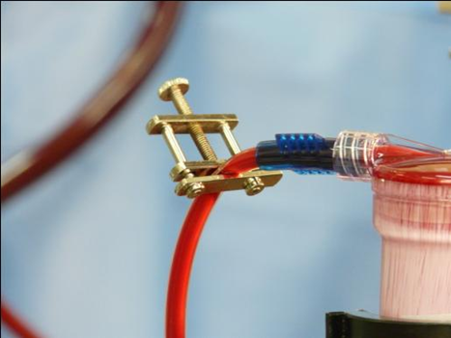
PCRRT in ECMO
Managing Pressure
No CRRT device is FDA approved/designed for use with ECMO
Pressure alarms are common
Too negative/positive drain pressures
Too negative/positive return pressures
No uniform solution currently exists
Changing/removing alarm parameters
Adding flow restriction via tubing/clamps
Altering circuit entry points
Notes:
Once the RRT system is in line with the ECMO circuit, alarms may occur due to the pressure monitors on the RRT system. Currently there is no consistent method/solution for this, and this can be address by altering the entry site on the ECMO circuit , commonly a flow resistor such as this Hoffman clamp or by resistance tubing can be down or adjustment of the alarm setting. Further work to address these issues is ongoing.

Slide 27
PCRRT in ECMO
Summary:
CRRT can be provided in line with ECMO
With ability to meet nutritional goals more readily
with improved fluid balance
with decreased furosemide exposure
Potential risks of excess fluid removal but close monitoring with scheduled weighed UF volume can identify this early for adjustment during therapy.
Success of ECMO and CRRT dependent on the primary disease and it’s expression within the patient
Notes:
In summary : CRRT in tandem with ECMO allows not only support for the patient with AKI but also to reach the nutritional goals more timely as well as Fluid balance control, To limit ongoing heavy use of diuretics which may harm their only risk assoication. Although Mortality Odd ratio is increased in children on ECMO with CRRT this may well be related to the underlying primary disease process that led to the organ failure.

