Slide 1
Access
If you don’t have it you might as well go home.
This is the most important aspect of CRRT therapy.
    Adequacy.
    Filter life.
    Increased blood loss.
    Staff satisfaction.

Slide 2
Vascular Access
Ideal Catheter Characteristics
  Easy Insertion
  Permits Adequate Blood Flow without Vessel Damage
  Minimal Technical Flaws
    High Recirculation Rate
    Kinking
Shorter and Larger Catheters
SIZE DOES MATTER
  Lower Resistance
  Improved Bloodflow

Slide 3
Vascular Access for CRRT
Match catheter size to patient size and anatomical site
One dual- or triple-lumen or two single lumen uncuffed catheters
Sites
  femoral
  internal jugular
  avoid sub-clavian vein if possible

Slide 4
Pediatric CRRT Vascular Access:
Performance = Blood Flow
Minimum 30 to 50 ml/min to minimize access and filter clotting
Maximum rate of 400 ml/min/1.73m² or
  10-12 ml/kg/min in neonates and infants
  4-6 ml/kg/min in children
  2-4 ml/kg/min in adolescents

Slide 5
Vascular Access
Two questions to be answered-
What size catheter to use?
Where to put it?

Slide 6
Vascular Access
ppCRRT Registry Access Study
13 Pediatric Institutions
376 patients
1574 circuits
Circuit survival by Catheter size, site, and modality
Hackbarth R et al: IJAIO 30:1116-21, 2007

Slide 7
Vascular Access
Hackbarth R et al: IJAIO 30:1116-21, 2007

Slide 8
Hackbarth R et al: IJAIO 30:1116-21, 2007

Slide 9
Vascular Access
1st 72 hrs of circuit
life only
Shorter life span
for 7 and 9 French
catheters (p< 0.002)
Hackbarth R et al: IJAIO 30:1116-21, 2007

Slide 10
Hackbarth R et al: IJAIO 30:1116-21, 2007

Slide 11
Vascular Access
“Location, location, location!”
Femoral Vein
Pros:
Accessible under almost any conditions
Easier to maintain hemostasis
Cons:
Potential for kinking
More recirculation
Thrombosis
Problematic flow with increased abdominal pressures

Slide 12
Vascular Access
“Location, location, location!”
Subclavian Vein
Pros:
Shorter catheter/better flow
Less recirculation
Cons:
Potential for kinking
Difficult hemostasis
Potential for venous narrowing
Less accessible with cervical trauma

Slide 13
Vascular Access
“Location, location, location!”
Internal Jugular Vein
Pros:
Shorter catheter/better flow
Less recirculation
Cons:
Difficult hemostasis
Less accessible with cervical trauma
Catheter length problematic in small infants

Slide 14
Hackbarth R et al: IJAIO 30:1116-21, 2007

Slide 15
Vascular Access
Survival favors IJ
Location (p< 0.05)
Hackbarth R et al: IJAIO 30:1116-21, 2007

Slide 16
Vascular Access
Catheter proximity
Inadvertent removal of infusions
Circuit clotting with platelet transfusions
Entraining calcium into the circuit

Slide 17
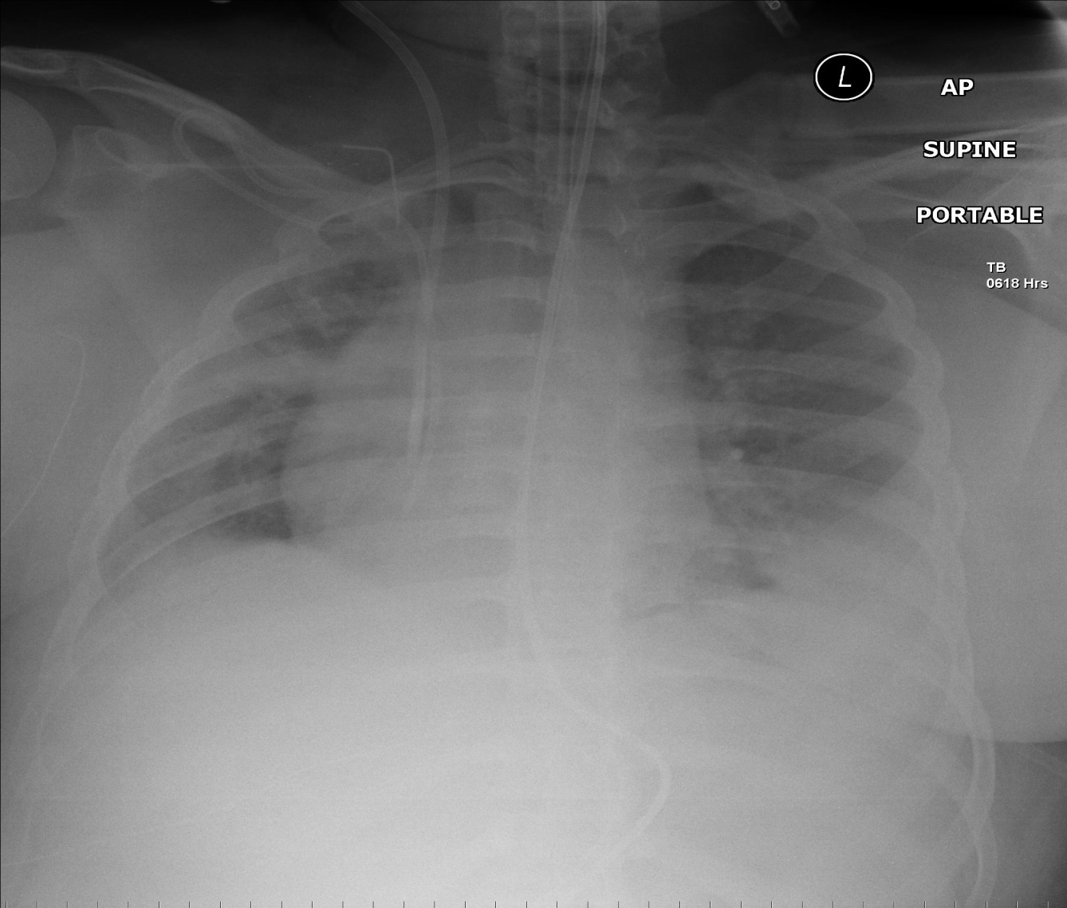
Vascular Access
Note the relationship of the line tips.

Slide 18
Vascular Access for Pediatric CRRT
(Hackbarth et al, CRRT 2005)
Children on CRRT/24 months
Age range 2 days – 18 yrs
Wt range 2.5-78 Kg
Citrate anticoagulation
Avg circuit life 3.1 days (0.3-11 days)
Access was size dependent

Slide 19
Vascular Access for Pediatric CRRT
(Hackbarth et al, CRRT 2005)
7 Fr dual lumen with clot in 50%
  Avg BFR 27 mls/min
8 Fr dual lumen with clot in 20%
  Avg BFR 73 mls/min
12 Fr triple lumen with no clot in any
  Avg BFR 127 mls/min
  This was used in in all children > 35 kg

Slide 20
Vascular Access
What size catheter should we use?
Don’t use a 5 French catheter.
Choose the largest diameter that is safe for the child.
Choose the smallest catheter that will achieve the necessary flow easily.
Choose the the minimum length to position the tip for optimal flow.
In the femoral position, longer catheters will minimize recirculation

Slide 21
Vascular Access
Where should the catheter go?
What sites are available?
Are there anatomic or physiologic constraints?
Which vessel is optimal for the catheter size?
Is the patient coagulopathic?
Consider patient mobility and risk of kinking.
Is there elevated intra-abdominal pressure?

Slide 23


