Slide 1
AKI Definitions
Stuart L. Goldstein, MD
Professor of Pediatrics
University of Cincinnati College of Medicine
Director, Center for Acute Care Nephrology
Nephrology and Hypertension
The Heart Institute
Cincinnati Children’s Hospital Medical Center

Slide 2
Outline
Review current AKI definitions
RIFLE
pRIFLE
AKIN
KDIGO
Application of definitions across populations
Effect of volume status on AKI epidemiology
Set the stage for Devarajan, Chawla and Symons

Slide 3
AKI Definitions to 2002
Over 30 definitions in published literature
Nearly all based on absolute/change in serum creatinine concentration
Pediatric AKI definitions
100% rise in SCr
eCCL < 75 ml/min/1.73m²
SCr twice normal for patient age
All AKI was created equal – no dimensionality

Slide 4
Is All AKI Created Equal?
Recent adult patient data demonstrate
Small SCr rises associated with mortality
AKI associated with mortality and length of hospitalization
AKI is now recognized as risk factor for poor outcome, independent of severity of illness

Slide 5
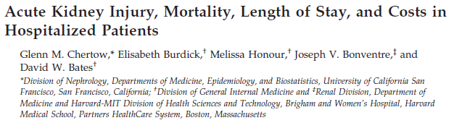
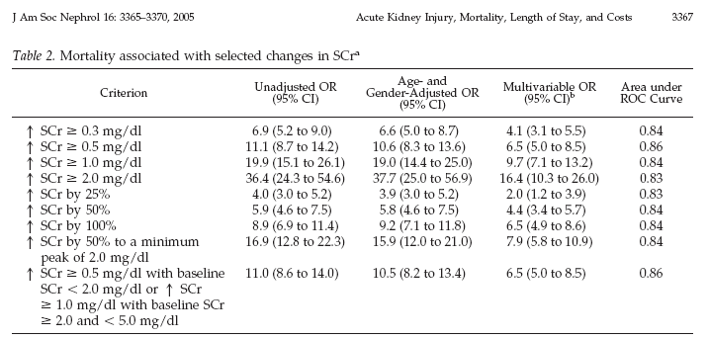

Slide 6
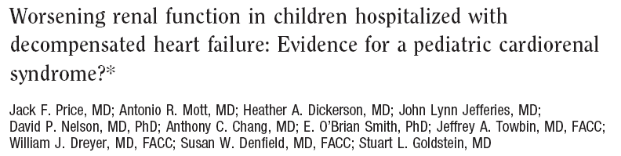

Slide 7
All AKI is NOT Created Equal
Multidimensional classification system is needed to
Grade AKI severity
Follow changes in kidney function
Standardize AKI as a hard outcome measure

Slide 8
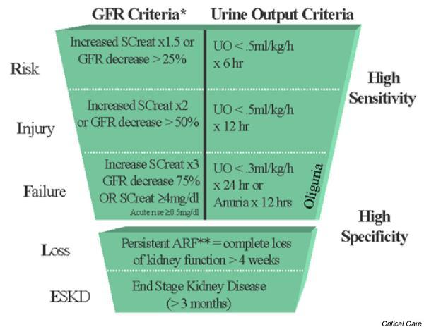
AKI RIFLE Criteria: ADQI II

Slide 9

Mortality increases with RIFLE strata
in every study

Slide 10
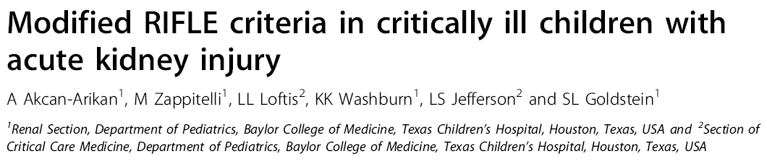
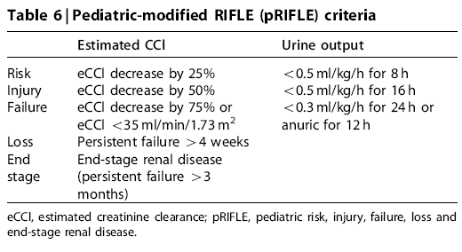
eCCl determined by Schwartz formula
Baseline eCCl from three months before PICU
120 ml/min/1.73m² if no data available
pRIFLE differs from RIFLE in
Oliguria duration
RIFLE-F limit eCCl

Slide 11
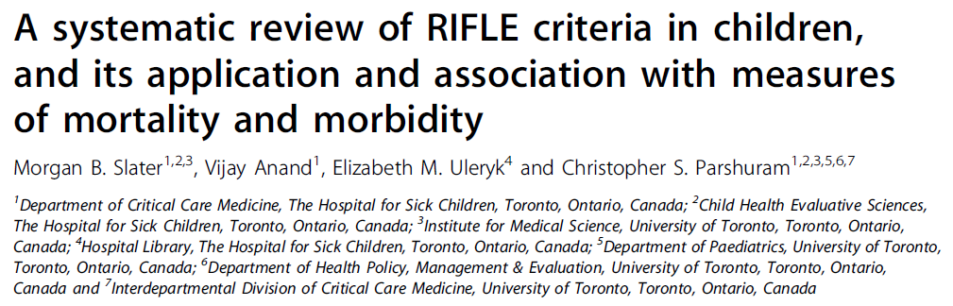
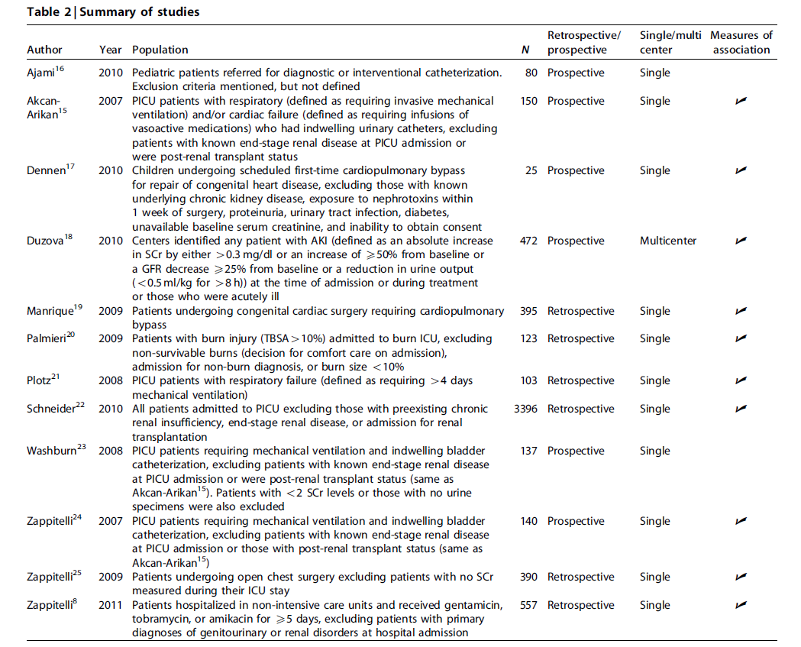
Additional 11 studies in past year alone
Total patients= 9,825
Nephrotoxic medications
Post CPB
Emergency center
Biomarker outcomes
Kidney transplant
Trauma

Slide 12
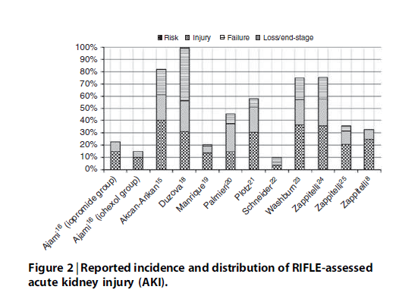
pRIFLE AKI rates and distributions varied with populations studied
Most studies show association between pRIFLE-I/F and mortality or LOS
Criteria not uniformly applied across studies
Outcomes associated with pRIFLE-I or –F
pRIFLE-I (100% SCr rise) used for risk stratification comparison across populations in Renal Angina development
We should use pRIFLE-R to direct “low hanging fruit” management change

Slide 13
AKIN Definition

Slide 14
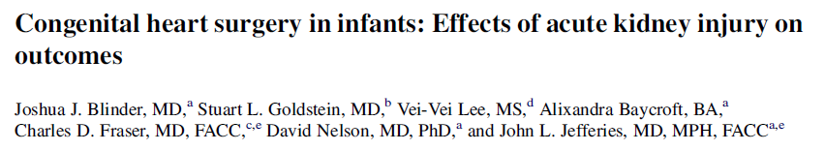
Retrospective analysis of 490 infants (age <90 days)
All underwent cardiac surgery requiring cardiopulmonary bypass
Postoperative AKI (AKIN criteria) occurred in 225 patients (52.3%)

Slide 15
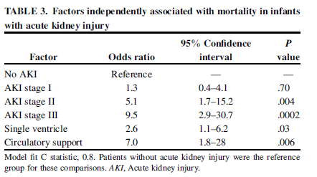
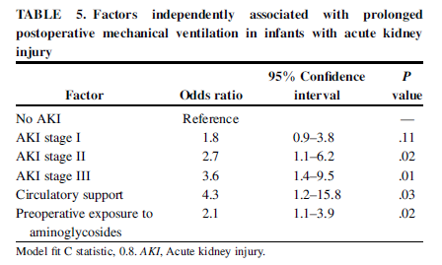

Slide 16
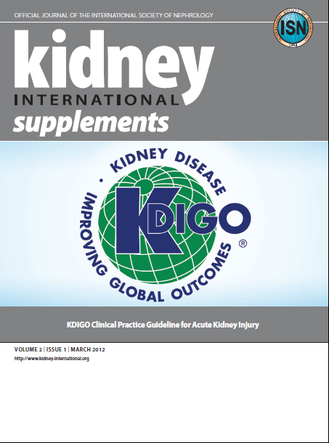

Slide 17

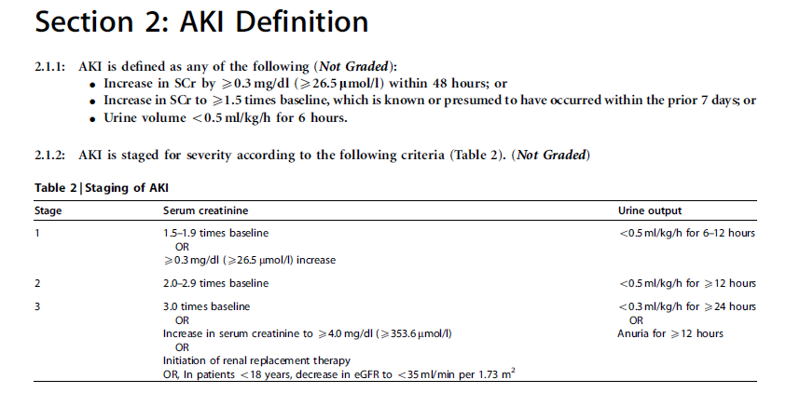

Slide 18
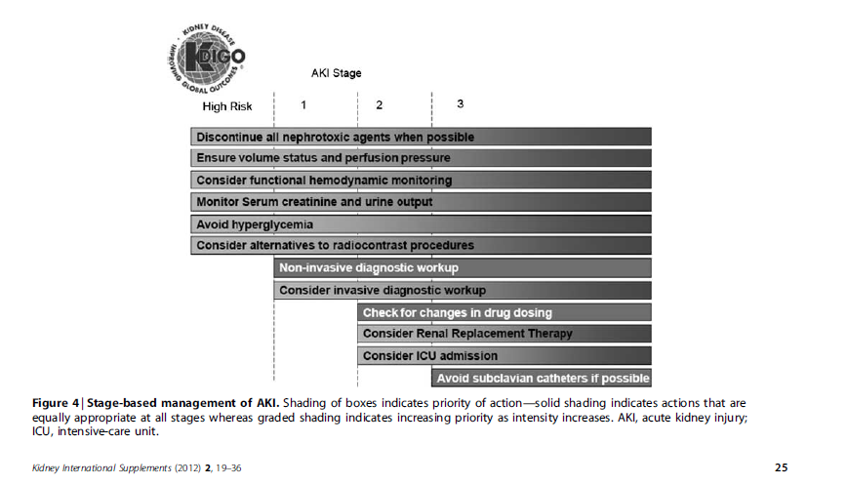

Slide 19
1000 patients in the ARDSnet study
Liberal vs. conservative fluid strategy
Patients in the liberal strategy
group received:
More fluid boluses
Less diuretics

Slide 20
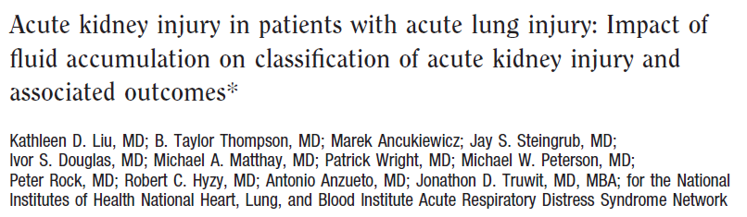
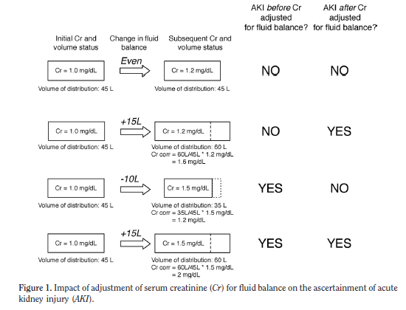

Slide 21
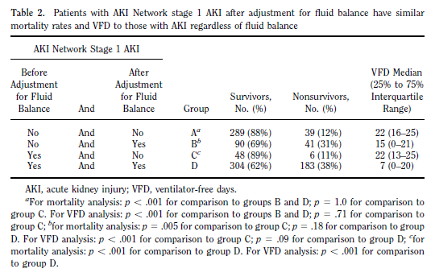
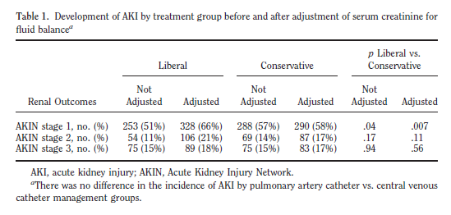

Slide 22
Summary
Standardized AKI definitions demonstrate small rises in creatinine are independently associated with poor outcomes
Standardized AKI severity strata demonstrate worsening AKI severity increases the rate of poor outcomes
Fluid overload may mask creatinine based AKI detection, underestimating AKI rates

Slide 23
Conclusions: Setting the Table
Serum creatinine change is a late functional biomarker of AKI
Devarajan to discuss novel AKI damage markers
Identification of AKI risk in paramount to directing stage based AKI management and biomarker assessment
Chawla to discuss the Renal Angina prodrome concept
When to initiate supportive and/or therapeutic maneuvers depends upon a standard AKI definition
Symons to discuss present supportive options
Devarajan to discuss future therapeutic options

Slide 24


Slide 25
