Slide 1
AKI: Emerging Therapeutic Options
Prasad Devarajan, MD
Professor of Pediatrics and Developmental Biology
University of Cincinnati College of Medicine
Director, Nephrology and Hypertension
Director, Nephrology Clinical Laboratory
CEO, Dialysis Unit
Cincinnati Children’s Hospital Medical Center

Slide 2
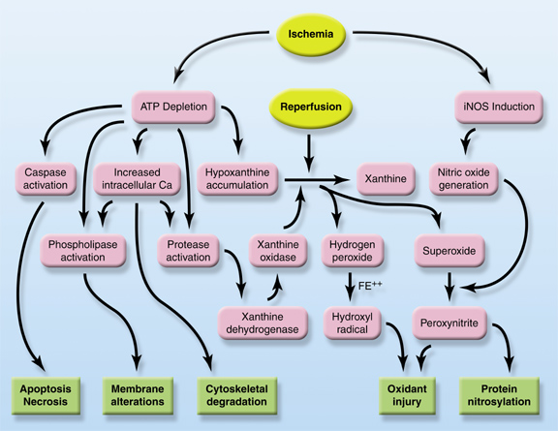
Biochemistry of AKI
Iron
Devarajan JASN 17:1503-20, 2006

Slide 3
Emerging Pharmacotherapies for AKI
Vasodilators
Fenoldopam
Apoptosis
inhibitors
Iron chelators
Iron
p53 siRNA
Deferiprone

Slide 4
Morphology of AKI
Devarajan JASN 17:1503-20, 2006

Slide 5
Emerging Pharmacotherapies for AKI
Anti-inflammatory
α-MSH analog
Repair
Stem Cells
Devarajan JASN 17:1503-20, 2006

Slide 6
Outline - Emerging Options for AKI Therapy
Apoptosis inhibitors
p53 siRNA
Iron chelators
Deferiprone
Anti-inflammatory agents
Alpha-melanocyte stimulating hormone (α-MSH) analog
Repair agents
Mesenchymal stem cells
All are currently undergoing clinical trials

Slide 7
AKI – Apoptotic Genes
Pro-apoptotic
p53
Bad
Bak
Fas/FADD
DAXX
Anti-apoptotic
Bcl-2
HGF
IGF-1
HB-EGF
PDGF
Supavekin Kidney Int 63:1714-1724, 2003

Slide 8
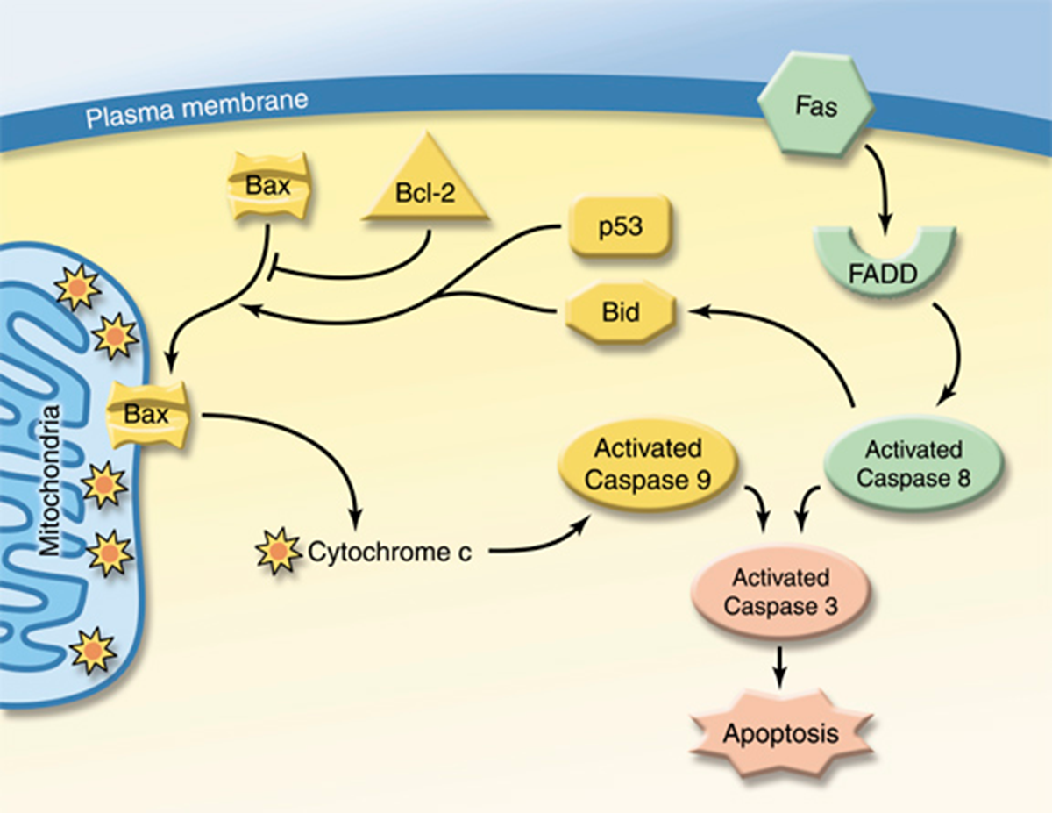
AKI: Apoptotic Mechanisms
Devarajan JASN 17:1503-20, 2006

Slide 9
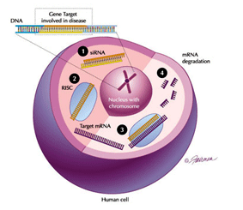
Small Interfering RNA (siRNA)

Slide 10
AKI: p53 siRNA – Animal Studies
Molitoris JASN 20:1754-64, 2009

Slide 11
AKI: p53 siRNA – Human Studies
Completed a multicenter Phase I/IIa, randomized, double-blind, dose escalation trial of the safety and pharmacokinetics of p53 siRNA in adults undergoing cardiovascular surgery with high AKI risk scores
Single IV injection within 4 hours of bypass
Pharmacokinetics during first 24 hours
Follow up for safety and dose limiting toxicities until hospital discharge and then by phone at 6 and 12 months post surgery
Quark Pharmaceuticals
ClinicalTrials.gov NCT00554359

Slide 12
AKI: p53 siRNA – Human Studies
Conducting a randomized, prospective, multicenter, Phase I/IIa dose escalation trial in adult patients to prevent delayed graft function after high risk deceased donor kidney transplant (cold ischemia time > 24 hours or from extended criteria donor)
Single IV dose
Primary outcomes: safety and pharmacokinetics
Secondary outcomes: incidence of DGF and rate of improvement in kidney function
Quark Pharmaceuticals
ClinicalTrials.gov NCT00802347

Slide 13
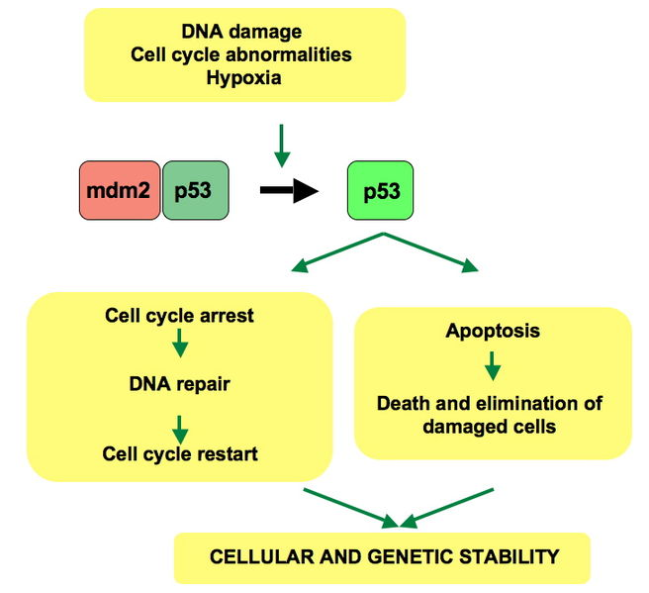
p53 siRNA – What they’re not telling you ...
p53 – “guardian of the genome”
Tumor suppressor
Prevents gene mutations
Conserves genome stability
p53 - “policeman of cell damage”
Activates DNA repair
Promotes apoptosis of the irreparably damaged cells
p53 inhibition may result in excessive proliferation of damaged cells and accumulation of mutations – both renal and extra-renal

Slide 14
Outline - Emerging Options for AKI Therapy
Apoptosis inhibitors
p53 siRNA
Iron chelators
Deferiprone
Anti-inflammatory agents
Alpha-melanocyte stimulating hormone (a-MSH) analog
Repair agents
Mesenchymal stem cells
All are currently undergoing clinical trials

Slide 15
Iron Chelation in Experimental AKI
Extensive basic science evidence for the role of labile iron in AKI
Iron chelation shown to have anti-oxidant , anti-apoptotic, and pro-proliferative roles in experimental AKI

Slide 16
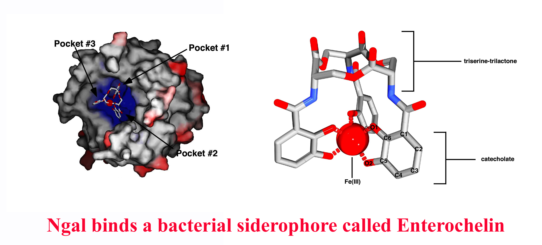
An Endogenous Iron Chelator
NGAL-Siderophore
(Kd = 0.4 nM)
Siderophore-Iron
(Kd = 10⁻⁴⁹ M)

Slide 17
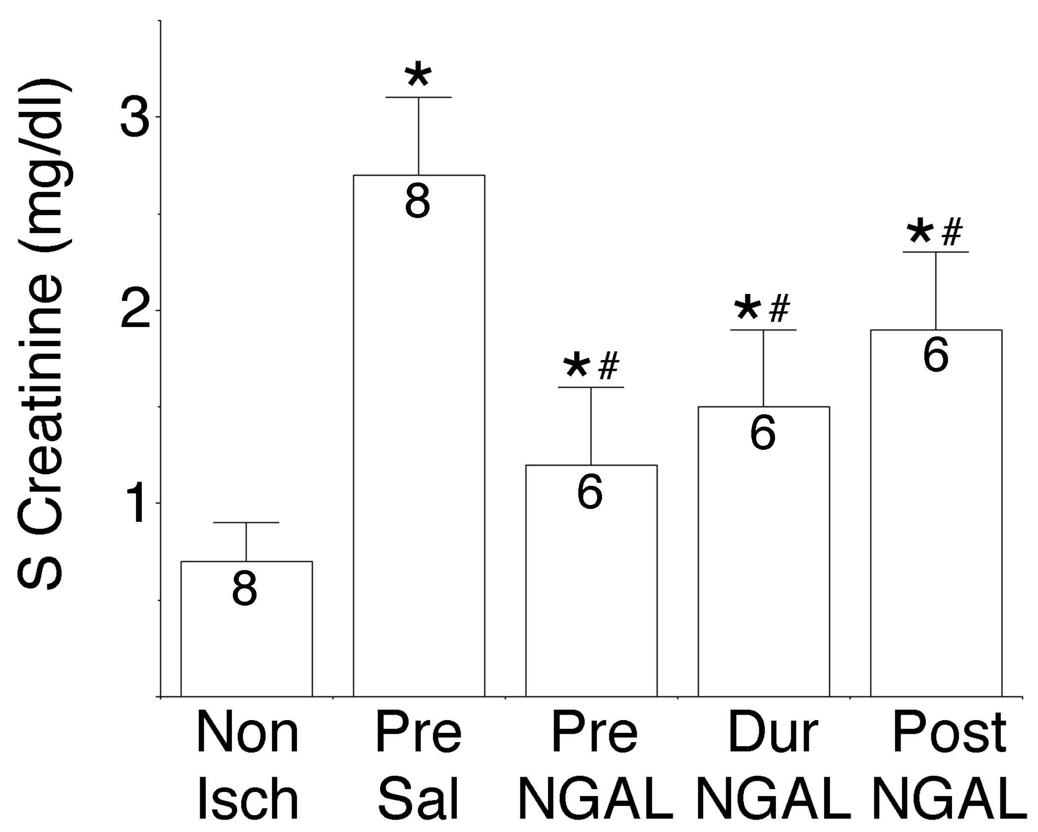
An Endogenous Iron Chelator Ameliorates AKI
2 hours post-ischemia only
Mishra et al, JASN 15:3073-82, 2004

Slide 18
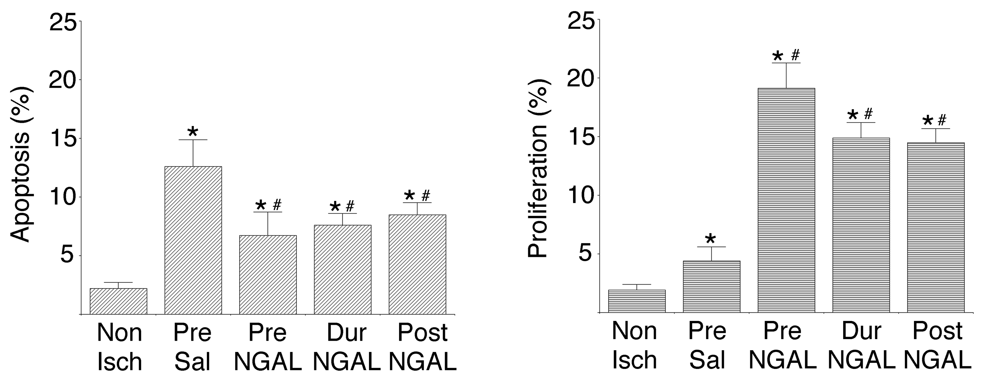
An Endogenous Iron Chelator Ameliorates AKI
Mishra et al, JASN 15:3073-82, 2004

Slide 19
Deferiprone Iron Chelator in AKI
FDA-approved as an oral therapy to treat thalassemia patients with iron overload due to blood transfusions
Completed Phase II randomized, double-blind, placebo-controlled trial to assess efficacy and safety of oral deferiprone (given before and then BID for 8 days after angiography)
primary outcome: change in novel AKI biomarkers
secondary outcome: change in serum creatinine
CorMedix
ClinicalTrials.gov NCT01146925

Slide 20
Deferiprone Iron Chelator in AKI
Starting Phase III randomized, double-blind, placebo-controlled trial to assess efficacy and safety of oral deferiprone (given before and then BID for 8 days after angiography) in adults with pre-existing CKD
primary outcome: a composite of specified renal and cardiovascular clinical events occurring through Day 90
CorMedix
ClinicalTrials.gov NCT01146925

Slide 21
Deferiprone – What they’re not telling you ..
Efficiency of targeting an orally administered chelator to the toxic ferric iron in renal tubules in AKI (vasoconstriction)
Systemic side effects of generalized iron chelation - other iron chelators (deferoxamine) cause systemic hypotension
Black box warning – neutropenia and agranulocytosis
May lead to progressive hepatic fibrosis

Slide 22
Outline - Emerging Options for AKI Therapy
Apoptosis inhibitors
p53 siRNA
Iron chelators
Deferiprone
Anti-inflammatory agents
Alpha-melanocyte stimulating hormone (α-MSH) analog
Repair agents
Mesenchymal stem cells
All are currently undergoing clinical trials

Slide 23
AKI: α-MSH – Animal Studies
Potent anti-inflammatory and anti-apoptotic cytokine
Decreases several pro-inflammatory cytokines (TNF-α, IL-10), neutrophil adhesion molecules, and nitric oxide production
Protects from AKI due to ischemia-reperfusion, nephrotoxins, and sepsis
Star PNAS 1995; 92:8016-20
Chiao JCI 1997; 99:1165-72

Slide 24
α-MSH Analogue
Native α-MSH: SYSMEHFRWGKPV
AP214 analogue: KKKKKKSYSMEHFRWGKPV
AP214 has about a 10-fold greater binding affinity for the melanocortin receptors compared to native α-MSH
Action Pharma/Abbott

Slide 25
α-MSH in Septic AKI
Doi KI 2008; 73:1266-74

Slide 26
α-MSH in Septic AKI
Doi KI 2008; 73:1266-74

Slide 27
AKI: α-MSH – Human Studies
Completed a multicenter Phase II, randomized, double-blind, placebo-controlled, safety and efficacy trial in adults undergoing high-risk cardiovascular surgery
Primary outcome: safety and tolerability - analysis of adverse events, serious adverse events, and changes in laboratory parameters over 90 days
Primary outcome: efficacy – serum creatinine changes over 7 days
Secondary outcome: efficacy – serum creatinine and eGFR changes over 90 days
Developing another larger Phase IIb trial
Action Pharma/Abbott
ClinicalTrials.gov NCT01256372

Slide 28
α-MSH – What they’re not telling you ….
Efficiency of targeting an IV agent to the renal tubules in AKI (vasoconstriction)
Systemic side effects
Effects of blocking anti-inflammatory cytokines
Effects of blocking systemic apoptosis (excessive proliferation of damaged or malignant cells)

Slide 29
Outline - Emerging Options for AKI Therapy
Apoptosis inhibitors
p53 siRNA
Iron chelators
Deferiprone
Anti-inflammatory agents
Alpha-melanocyte stimulating hormone (α-MSH) analog
Repair agents
Mesenchymal stem cells
All are currently undergoing clinical trials

Slide 30
AKI: Mesenchymal Stem Cells
AKI induces SDF-1 in renal tubules
SDF-1 promotes MSC homing to sites of injury
MSCs remain in the injured kidney only transiently, and do not differentiate and repopulate the tubules
MSCs promote kidney repair by secreting a number of growth factors (including VEGF, HGF, IGF-1)
These paracrine mediators have potent anti-apoptotic, mitogenic, anti-inflammatory, and angiogenic properties
Togel KI 2005; 67:1772-84
Togel Stem Cells Dev 2009; 18:475-85

Slide 31
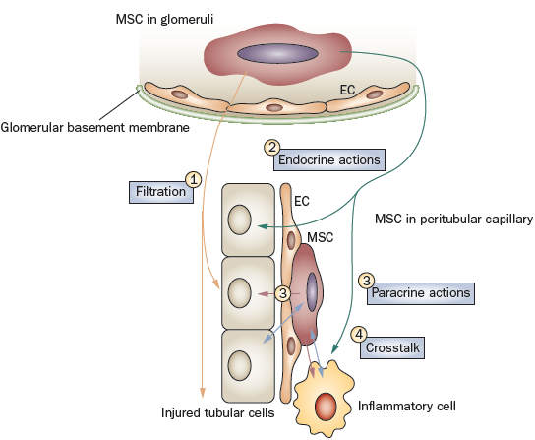
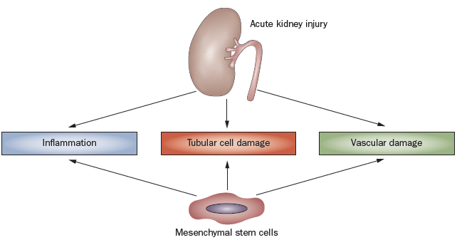
AKI: Mesenchymal Stem Cells
Togel & Westenfelder Nat Rev Nephrol 2010; 6:179-83

Slide 32
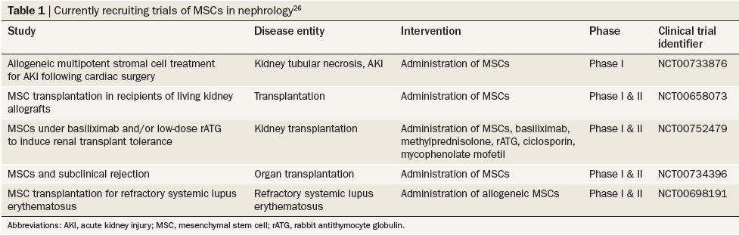
AKI: MSCs – Human Studies
Togel & Westenfelder Nat Rev Nephrol 2010; 6:179-83

Slide 33
Modified Mesenchymal Stem Cells
AC607 – expanded from normal bone marrow cells that are modified to be
Immune privileged – avoids detection by the immune system
No need for blood or tissue typing
Genetically stable (not transformed or induced)
Reliable supply
Allocure

Slide 34
AKI: Modified MSCs – Human Studies
Recruiting for a multicenter, double-blind, placebo-controlled, Phase II study of AC607 for the treatment of AKI after cardiac surgery (0.5 mg/dl or greater rise in serum creatinine within 24 hours of CPB)
Single IV administration of AC607 or vehicle
Primary outcome: time to kidney recovery
Secondary outcome: mortality or dialysis within 90 days
AlloCure
ClinicalTrials.gov NCT01602328

Slide 35
MSCs – What they’re not telling you ….
Efficiency of targeting an IV agent to the renal tubules in AKI (vasoconstriction)
Homing to other organs
Effects of blocking systemic apoptosis (excessive proliferation of damaged or malignant cells)

Slide 36
Summary - Emerging Options for AKI Therapy
Apoptosis inhibitors
p53 siRNA
BMP receptor ligands
Iron chelators
Deferiprone
Anti-inflammatory agents
Alpha-melanocyte stimulating hormone (α-MSH) analog
Recombinant Alkaline Phosphatase
Repair agents
Modified mesenchymal stem cells
Devices
Benephit intrarenal drug delivery catheter
Renal Assist Device
Currently undergoing clinical trials

Slide 37
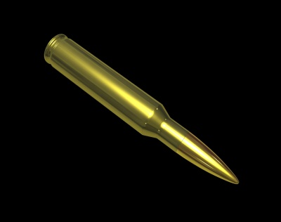

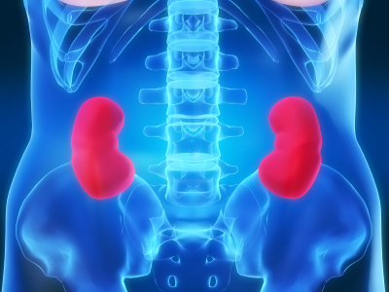

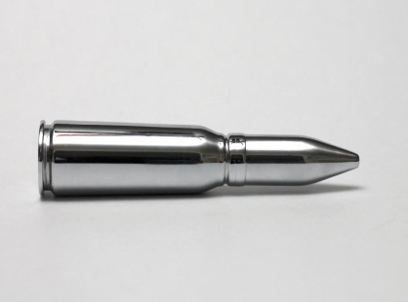
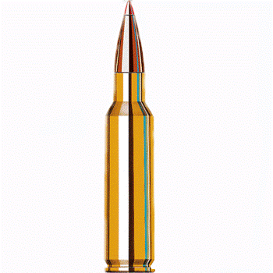
AKI: No Magic Bullet Yet ……

Slide 38
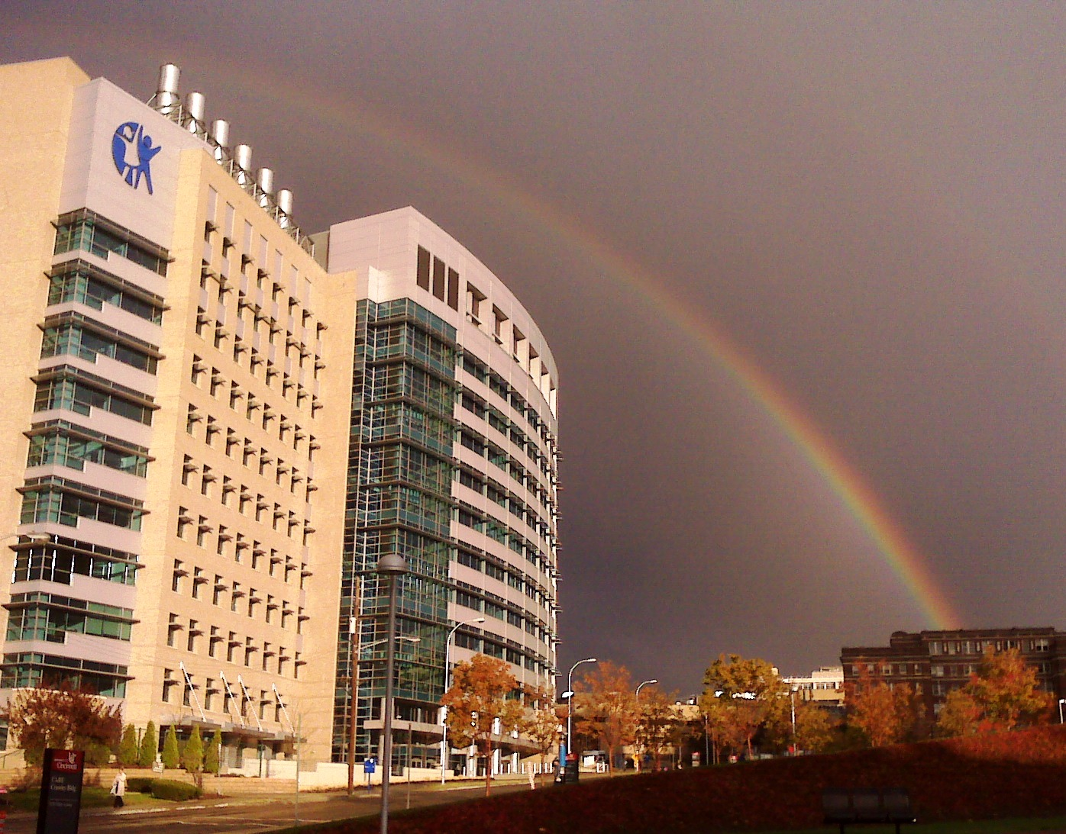
AKI: The Future is Bright ……
Thank you for your participation!

