Slide 1
AKI: The “Omics”
Prasad Devarajan, MD
Professor of Pediatrics and Developmental Biology
University of Cincinnati College of Medicine
Director, Nephrology and Hypertension
Director, Nephrology Clinical Laboratory
CEO, Dialysis Unit
Cincinnati Children’s Hospital Medical Center

Slide 2
Outline
Genomics
Targeted sequencing
GWAS
Microarrays
Next Gen Sequencing
Proteomics
2-D Gels
MALDI/SELDI-TOF
Isotope Tagging
LC-MS
Techniques and application to AKI

Slide 3
Outline
Genomics
Targeted sequencing
GWAS
Microarrays
Next Gen Sequencing
Proteomics
2-D Gels
MALDI/SELDI-TOF
Isotope Tagging
LC-MS
Techniques and application to AKI

Slide 4
Targeted Sequencing
Candidate gene approach
Look for polymorphisms in genes whose protein products are known to be associated with AKI
Standard DNA sequencing
Compare controls versus AKI populations

Slide 5
Targeted Sequencing in AKI
Only one polymorphism (in the APO E gene, which regulates inflammation) associates with AKI in more than one study
Eight other polymorphisms associate with AKI in single studies
    Oxidative stress genes: NADPH oxidase, Catalase
    Vasomotor regulation genes: ACE
    Inflammatory genes: TNF-α, IL-10, IL-6
    Cytoprotective genes: HSP72, Haptoglobin
Polymorphisms in most of these genes have also been linked to many other disease states
Interesting, but not yet clinically helpful to define genetic risk for AKI
Lu CJASN 2009; 4:1020-31

Slide 6
Outline
Genomics
Targeted sequencing
GWAS
Microarrays
Next Gen Sequencing
Proteomics
2-D Gels
MALDI/SELDI-TOF
Isotope Tagging
LC-MS
Techniques and application to AKI

Slide 7
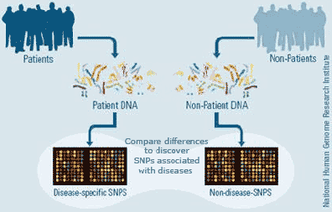
GWAS
Genome Wide Association Study
Look for single nucleotide polymorphisms (SNPs) in all genes, and for associations with disease states
DNA from blood or buccal smear
Hybridized to chips
SNPs identified by automatic scanners
Genome-Wide Human SNP Array Chips that feature nearly 1 million SNPs

Slide 8
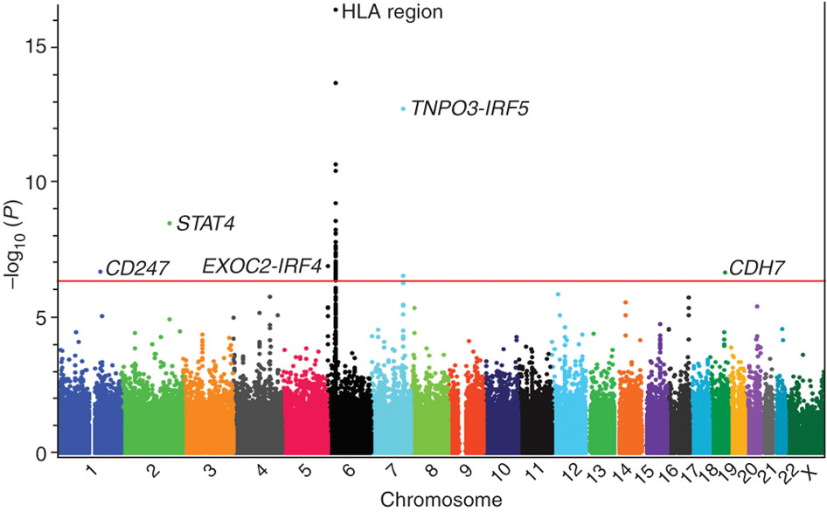
GWAS Data – A Simple Study
Manhattan Plot of 2,346 systemic sclerosis cases and 5,193 healthy controls
Nature Genetics 42:426-9, 2010

Slide 9
GWAS Data – A More Complex Study
2.5 Million SNPs in 70,000 individuals: variants in 29 genes associated with high BP
Nature 2012; 478:103-9

Slide 10
GWAS in AKI
Only one small study reported to date
158 patients with severe blunt trauma and no previous evidence for kidney disease
33 developed AKI (RIFLE) and 125 did not
GWAS study showed no differences in genomic sequences between the two groups
Much larger studies are currently in the planning stages
Bihorac, Ann Surg 2010; 252:158-65

Slide 11
Outline
Genomics
Targeted sequencing
GWAS
Microarrays
Next Gen Sequencing
Proteomics
2-D Gels
MALDI/SELDI-TOF
Isotope Tagging
LC-MS
Techniques and application to AKI

Slide 12
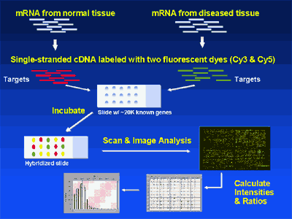
cDNA Microarrays

Slide 13
Microarrays in AKI
Tons of data!
Deposited in Gene Expression Omnibus (GEO)
http://www.ncbi.nlm.nih.gov/geo
Goldmine for computer geeks!!

Slide 14
Microarrays in AKI – Top Ten
Lots more data mining at
http://www.ncbi.nlm.nih.gov/geo

Slide 15
Outline
Genomics
Targeted sequencing
GWAS
Microarrays
Next Gen Sequencing
Proteomics
2-D Gels
MALDI/SELDI-TOF
Isotope Tagging
LC-MS
Techniques and application to AKI

Slide 16
Next Gen Sequencing
The Human Genome Project spanned 13 years and cost over three billion dollars
The cost of DNA sequencing has dropped a million fold
Your entire genome can now be sequenced in a couple of weeks, for only four thousand dollars
http://www.signonsandiego.com/news/2011/may/09/illumina-drops-human-sequencing-price-4000/
The technology continues to improve at a pace that will render current techniques obsolete each year

Slide 17
Next Gen Sequencing
Next generation sequencing provides a digital analysis of gene expression levels
It also reveals alternative RNA processing, as well as distinct promoter site use
It is well suited for the analysis of micro RNAs
It is also a powerful tool for the analysis of methylation states of DNA
The power of Next Gen Sequencing has not been harnessed for the study of AKI

Slide 18
Outline
Genomics
Targeted sequencing
GWAS
Microarrays
Next Gen Sequencing
Proteomics
2-D Gels
MALDI/SELDI-TOF
Isotope Tagging
LC-MS
Techniques and application to AKI

Slide 19
Why is Proteomics Important?
This is the Post-Genomic Era
1990 2012
One gene = one protein Proteomics
23,000 human genes Metabolomi cs
>123,000 proteins

Slide 20
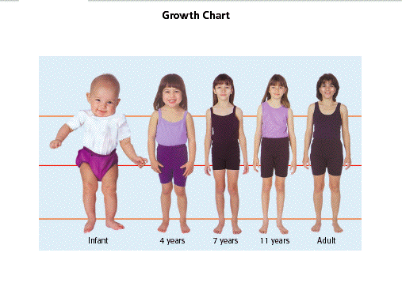
Why is Proteomics Important?
Proteomes are dynamic

Slide 21
Why is Proteomics Important?
Proteomes change rapidly, predictably, and uniquely with physiologic and pathologic changes in the individual
Proteomics can identify and quantify these changes, and is therefore indispensable to predictive and personalized medicine
Hood, Science 306:640-643, 2004
Weston and Hood, J Proteome Res 3:179-196, 2004
Vitzthum et al, J Proteome Res 4:1086-1097, 2005
Haselden, Nature Medicine 12:510-511, 2006

Slide 22
Clinical Proteomics: What is achieved?
Separation, identification, and quantitation of proteins in body fluids and tissues, in health and disease

Slide 23
Outline
Genomics
Targeted sequencing
GWAS
Microarrays
Next Gen Sequencing
Proteomics
2-D Gels
MALDI/SELDI-TOF
Isotope Tagging
LC-MS
Techniques and application to AKI

Slide 24
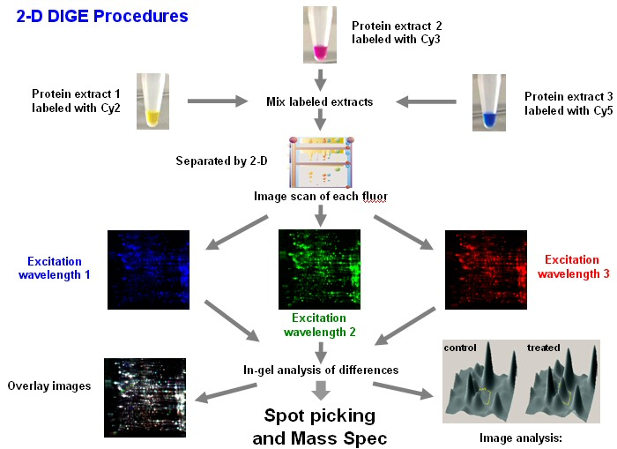
Proteomics: 2-D DIGE

Slide 25
2-D DIGE
Advantages
Well established technique
Good for low molecular weight proteins
Protein identification possible
Disadvantages
Laborious, not high throughput
Status
Important adjunct to high throughput methods

Slide 26
Outline
Genomics
Targeted sequencing
GWAS
Microarrays
Next Gen Sequencing
Proteomics
2-D Gels
MALDI/SELDI-TOF
Isotope Tagging
LC-MS
Techniques and application to AKI

Slide 27
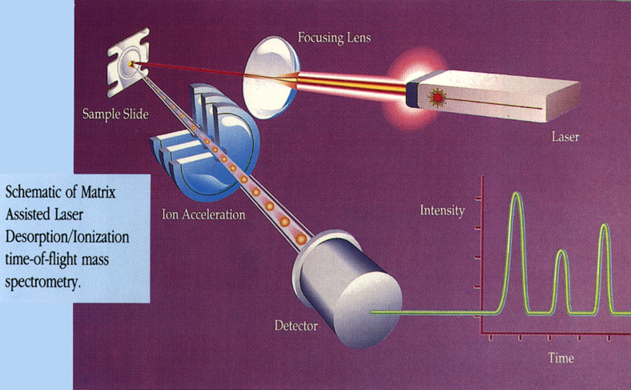
Proteomics: MALDI-TOF-MS

Slide 28
MALDI-TOF
Advantages
Well established technique
Good for low molecular weight proteins
Protein identification possible
Disadvantages
Laborious, not high throughput
Status
Important adjunct to high throughput methods

Slide 29
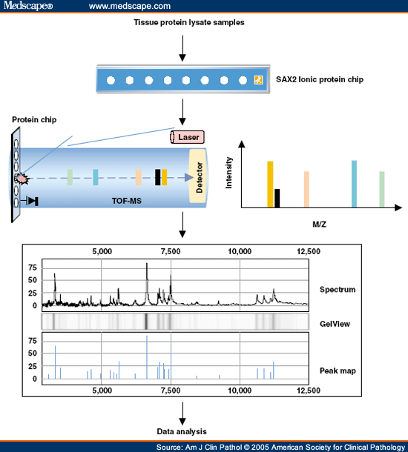
Proteomics: SELDI-TOF-MS

Slide 30
SELDI-TOF
Advantages
High throughput, rapid, small volume, inexpensive
Good for middle molecular weight proteins
Disadvantages
Not good for large and small proteins
Not easy to identify proteins
Status
Good as a high throughput screening method

Slide 31
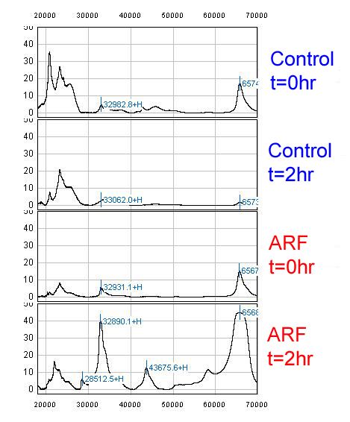
Proteomic Analysis of AKI

Slide 32
Proteomic Analysis of AKI
28
33
43
66

Slide 33
Proteomic Analysis of AKI
NGAL
A1MC
Alb
A1GP
Alb

Slide 34
Summary
Genomics
Targeted sequencing
GWAS
Microarrays
Next Gen Sequencing
Proteomics
2-D Gels
MALDI/SELDI-TOF
Isotope Tagging
LC-MS

Slide 35

CCHMC P50 Center of Excellence
Genomics
Targeted sequencing
GWAS
Microarrays
Next Gen Sequencing
Proteomics
2-D Gels
MALDI/SELDI-TOF
Isotope Tagging
LC-MS
AKI, Nephrotic Syndrome, Lupus Nephritis

Slide 36

Acknowledgements – Devarajan Lab
Thelma Kathman
Mike Bennett
Christie Cobb
Qing Ma

Slide 37
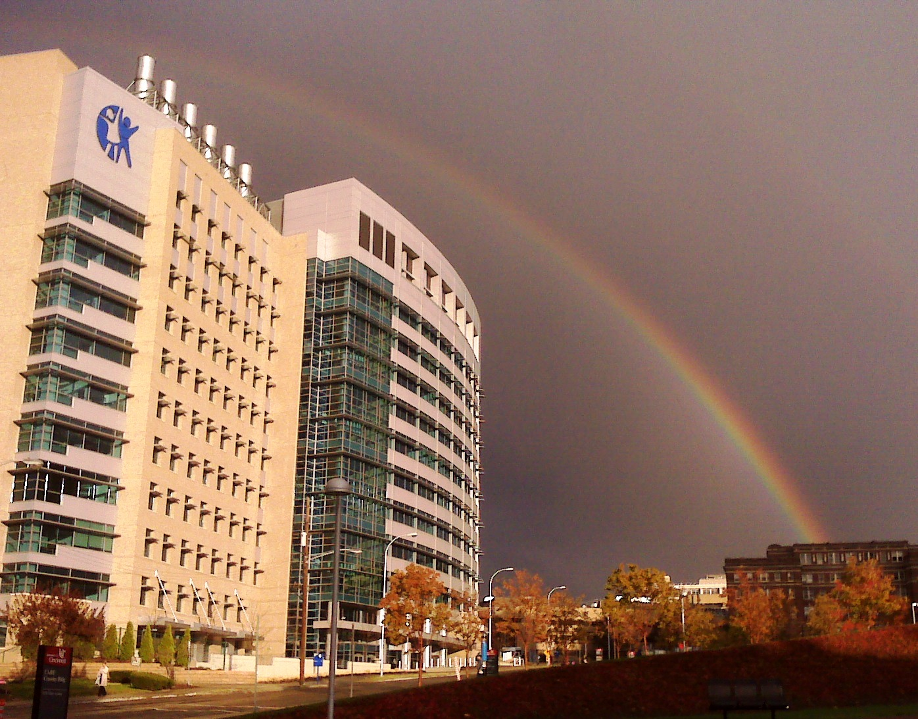
AKI: The Future is Bright ……
Thank you for your participation!

