Slide 1
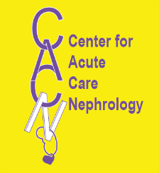
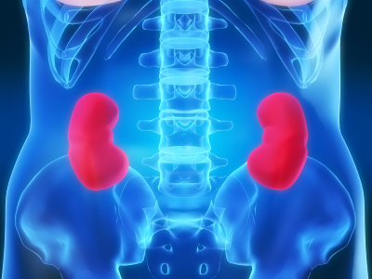
AKI – Biologic Models of Injury
Rajit K. Basu, MD
Assistant Professor, Division of Critical Care
Center for Acute Care Nephrology
Cincinnati Children’s Hospital Medical Center
1st International Symposium on AKI in Children
7th International Conference
Pediatric Continuous Renal Replacement Therapy
September 2012

Slide 2
Disclosures
Speaker is partially funded by the Gambro Renal Products for the TAKING-FOCUS clinical research study

Slide 3
Relevance
Pathophysiology of AKI is poorly understood
AKI – disease or syndrome?
Multifactorial
Propagative effects
Extra-renal effects of AKI
In vitro, in vivo, and ex vivo AKI models offer an analytical canvas otherwise unavailable
Understanding → recognition → therapy
“…I miss the days we could experiment on kids.” – T Bunchman – 42 hours ago
(this statement not IRB/IACUC approved)

Slide 4
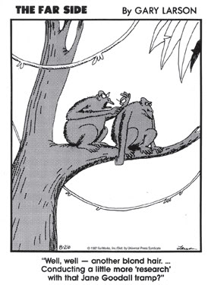
Outline
Discuss most prominent biologic models of AKI
Pro – Con debate
Effectiveness of bench→bedside model
Moving forward

Slide 5
The purpose of animal models and AKI
Understanding of AKI pathophysiology is incomplete
Multifactorial etiology
Offer therapeutic targets
Biomarker development
Targets (outcomes or function)
Number of models is high
Indexed citations of “animal models” and “acute kidney injury” → 1790
Broad categories to match primary assumed pathophysiology
Ischemic
Nephrotoxic
Septic

Slide 6

The biologic basis of AKI
Disrupted endothelial function
Hypoxia and dysoxia
Tubulopathy
Aberrant glomerular perfusion pressure
Apoptosis and necrosis
Aberrant arteriolar tone
Tubular epithelial toxicity
Notes:
A- CK-MB
B - Troponin
6

Slide 7
Primary AKI Model Paradigms
ISCHEMIA
REPERFUSION
SEPSIS
NEPHROTOXINS
Notes:
A- CK-MB
B - Troponin
7

Slide 8
Primary AKI Model Paradigms
ISCHEMIA
REPERFUSION
SEPSIS
NEPHROTOXINS
Notes:
A- CK-MB
B - Troponin
8

Slide 9
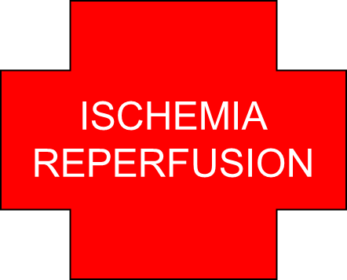
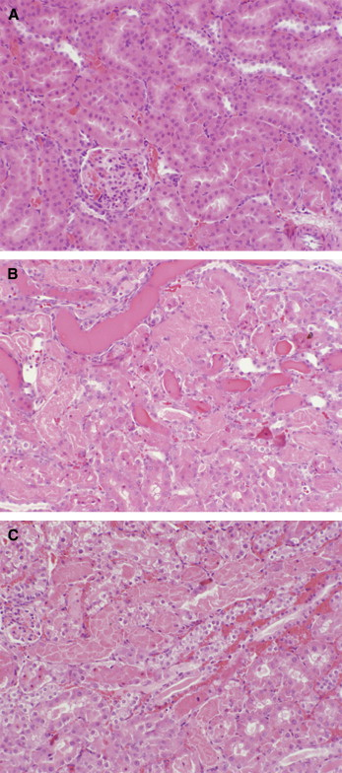
Ischemic AKI Models
Seems most physiologically “pure”
Clinical parallels
Hypovolemic dehydration (Gastroenteritis – worldwide pediatric AKI)
Cardiopulmonary bypass
Histology of ischemic injury
Often associated with scattered tubular necrosis
Dilation of proximal tubules
Intratubular casts
Glomeruli generally intact
Tubules are the focus?
Many models exist – strengths and weaknesses in place for each
3 Main Models of Ischemia
Cell culture
Isolated Tubules
Whole Animal

Slide 10
Ischemic AKI Models
Factors which contribute to AKI in ischemic models
Proximal tubule morphologic changes
Loss of cell polarity
Integrin and transporter loss of polarity
Loss of brush border / urine concentrating ability
Aberrant sodium handling
Decreased absorption at proximal tubule
Increased delivery to distal tubule
Activation of tubuloglomerular feedback → reduction of SN-GFR
Cast formation
Sodium in distal tubule → Tamm Horsfall protein polymerization
Casts/apoptotic cells in tubular cells
Loss of cell barriers/junctions

Slide 11
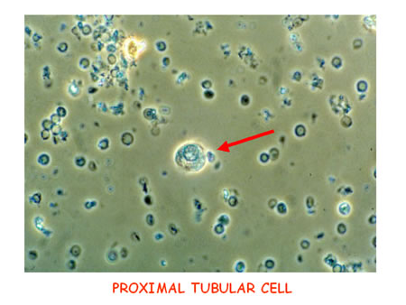
Ischemic AKI Models
Cell culture
Primary/Established lines - tubular cells
Tubular epithelial ischemia via ATP depletion
Inhibit mitochondrial respiration → loss of epithelial cell polarity, intercellular junction integrity impaired (Molitoris, KI 1996)
PRO:
Easy to obtain
Easy to control
Can isolate individual conditions
CON:
Not physiologic
In vitro cells are more resistant to hypoxic stress
Cells lose phenotype in culture

Slide 12
Ischemic AKI Models
Isolated whole tubules
Proximal tubules
Maintaining heterogeneity in cell population in tubules is more “representative”
Carry a varied response to hypoxia (Weinberg, J Clin Invest 1985)
PRO:
Cell phenotype stays constant (as does cell polarity)
Can study ‘early recovery’
Can isolate individual conditions
CON:
Isolation of tubules causes injury
Cannot assess inflammatory or vascular components to injury

Slide 13
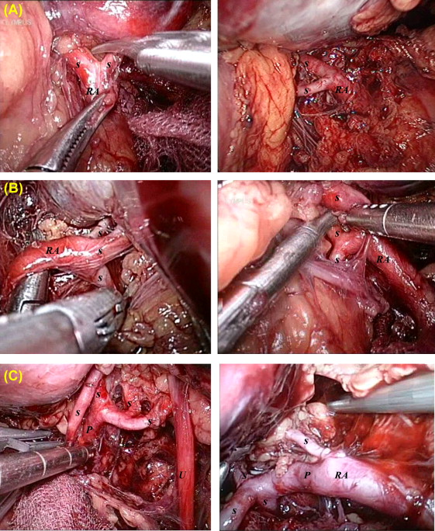
Ischemic AKI Models
Animal models
Cross clamping of renal pedicle for 15-60 minutes
Unilateral allows for internal ‘control’ and renal specific effects
Carry a varied response to hypoxia (Weinberg, J Clin Invest 1985)
Leads to proximal tubular cell necrosis
Recoverability mimics human phenotype (injury → recovery phases)
PRO:
Can test tubular, vascular, and inflammatory components simultaneously
Mimics human AKI
Can test therapy
CON:
One dimensional
May be animal specific differences
Good against a mouse may not be good enough

Slide 14
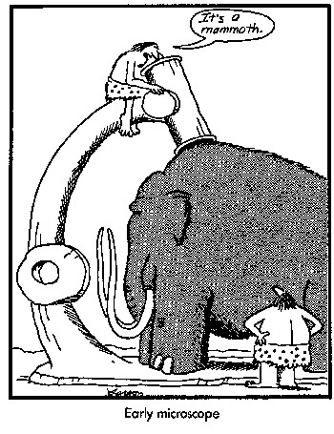
Ischemic AKI Models
Does the animal matter?
Mice, rats, rabbits, sheep, dogs, etc have varying thresholds of injury
Local and systemic responses vary
Medullary vessel anatomy and urinary concentrating ability varies amongst animals
Porcine kidney (system) may be most similar to humans (Lieberthal, AJPRP 2000)
Cost effectiveness of murine model makes it the most common

Slide 15
Ischemic AKI Models
Does injury occur from arterial or venous occlusion?
Or both?
Renal arterial occlusion vs. Renal venous occlusion (Li, AJPRP 2012)
Acute venous obstruction conferred greater injury than arterial occlusion
Time?
Longer ischemic time → arterial obstruction conferred greater injury
10 minutes of clamping → significant renal histopathologic injury
Other models of ischemia/occlusion → AKI
Cardiac arrest and CPR → AKI (Hutchens J Vis Exp 2011)
Abdominal aortic clamping → AKI

Slide 16
Ischemic AKI Models
Preconditioning?
Animals subjected to ischemia and reperfusion who recover
Re-injury results in less injury (resistance) (Bonventre Curr Opin Nephrol Hypertens 2002)
Cytoprotective mechanism activation
Reduced pro-inflammatory markers
May be a complicating factor for ‘translatability’ of bench→ bedside therapy

Slide 17
Ischemic AKI Model – Good and Bad
Models
Patients Animals Isolated Isolated Cell
(ATN) Kidneys Tubules Culture
Complexity
Expt Limitations
Able to manipulate
Isolation of variable
Understanding
Therapeutic Value
Adapted from Luyckx, Crit Care Neph

Slide 18
Primary AKI Model Paradigms
ISCHEMIA
REPERFUSION
SEPSIS
NEPHROTOXINS
Notes:
A- CK-MB
B - Troponin
18

Slide 19
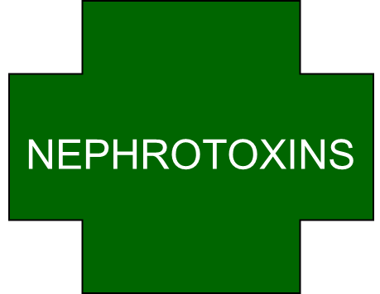
Nephrotoxin AKI Models
Kidney is at risk
High proportion of cardiac output = high exposure
Glomerulus drained by muscular vessel (arteriole) vs venule
Higher risk of hemodynamic effects of drugs
Filtration and metabolism of drugs leads to
High concentration of active drugs in tubules (toxins)
Concentration increases along length of nephrons
Luminal pH can affect solubility of drugs
Medulla is exposed

Slide 20
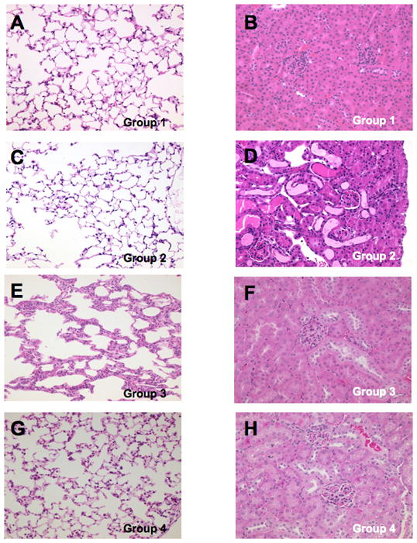
Models of Nephrotoxic AKI
Folic acid → AKI
Direct tubular injury
Dilated tubules
Intratubular cast formation
Intraparenchymal neutrophil accumulation

Slide 21
Models of Nephrotoxic AKI
Single insult toxins (Lieberthal, AJPRP 2000)
One dose may be enough
Cis-platin (Kusumoto, Clin Exp Neph 2011)
Delivered IP → reproducible tubular injury
Mercury
Enteral Inorganic mercury
Glycerol
IM injection of glycerol → model of rhabdomyolysis
Leads to intra-renal vasoconstriction
Heme mediated oxidant injury
Cast formation

Slide 22
Models of Nephrotoxic AKI
Aggregate toxins
High dose or combined doses lead to AKI
Aminoglycosides
High doses required (10x dose than in humans)
Synergistic response in gram negative bacteremia (Zager, JCI 1985)
Radiocontrast
Combined with stress of hypovolemia , single nephrectomy, prostaglandin inhibition → AKI
Similar to effect of radiocontrast in humans

Slide 23
Examples of Nephrotoxic AKI
Nephrotoxin | Why study?
Gentamicin | Enzyme leakage, energy metabolism
Heavy metals (Me, Ca, Cr) | Protein synthesis
Oxidant injury | Tubular permeability
Radiocontrast (Iodohexanol) | GFR, tubular morphology
Hydroquinones | Mitochondrial function
Cyclosporine | Toxin accumulation
Acetaminophen | Toxin accumulation
Chloroform | Organic acid accumulation
Immunosuppressants | Glomerular contractility

Slide 24
Primary AKI Model Paradigms
ISCHEMIA
REPERFUSION
SEPSIS
NEPHROTOXINS
Notes:
A- CK-MB
B - Troponin
24

Slide 25
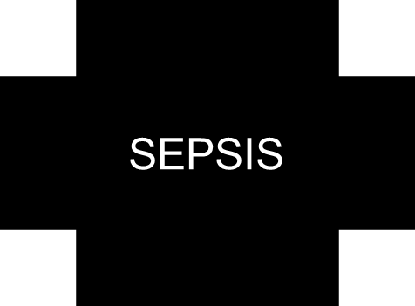

Septic AKI Models

Slide 26
Septic AKI Models
Sepsis and septic shock
Most common predisposing factor to AKI in critical care settings (Uchino, JAMA 2005)
Early mechanisms appear to be related to hemodynamics (Benes, Crit Care 2011)
Late mechanisms appear to be related to balance of pro and anti-inflammatory factors/recovery (Maddens, Crit Care Med 2012)
3 Common Models
Lipopolysaccharide toxin (LPS) from E. coli
Live bacteria administration
Cecal ligation and puncture

Slide 27
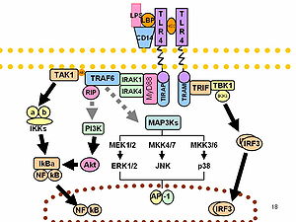
Septic AKI Models
LPS
Standardized, purchasable, dose related effect is stable
Injected IV, IM, SQ, IP as a bolus or continuous
LPS → Low blood pressure / hypo-dynamic circulatory state
Adults with sepsis and AKI more commonly have higher cardiac output (Parker, Crit Care Med 1987)
Pediatric patients are highly variable (though lower cardiac output more common)
Essentially confounds results (AKI from cardiogenic + septic shock)

Slide 28
Septic AKI Models
Live bacteria
E coli and P Aeruginosa typically used
Langenberg and Bellomo → renal hemodynamics and AKI (sheep)
Standardization is difficult
Injected IV, IM, SQ, IP as a bolus
Constant bacteremia is not common clinically
Bacteremia generally episodic (except endocarditis)

Slide 29
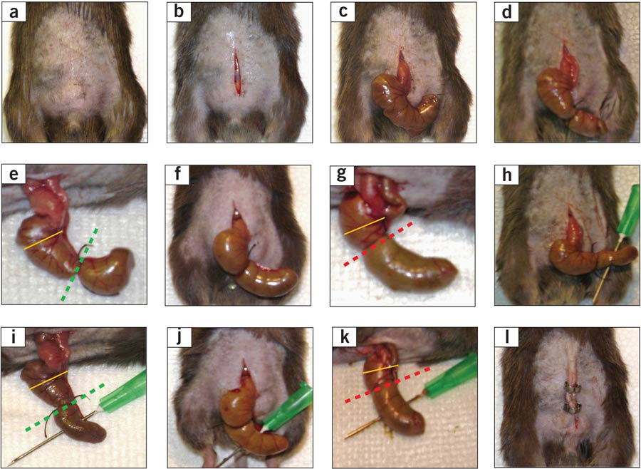
Septic AKI Models
Cecal ligation and puncture
Small laparotomy incision
Cecum located, ligated distal to ileocecal valve
Cecum punctured, feces expressed into peritoneum
Effect → polymicrobial sepsis
Most consistent with clinical sepsis (gram negative)

Slide 30
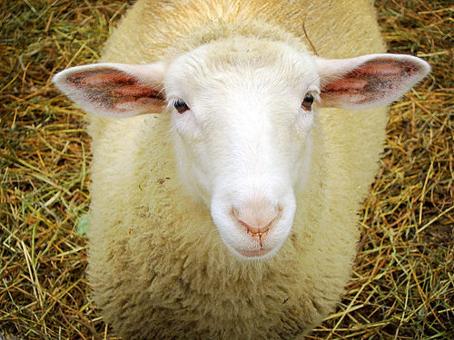
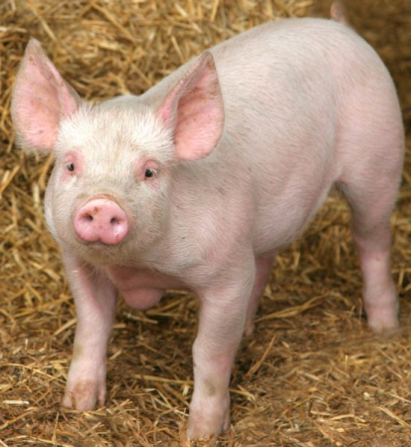
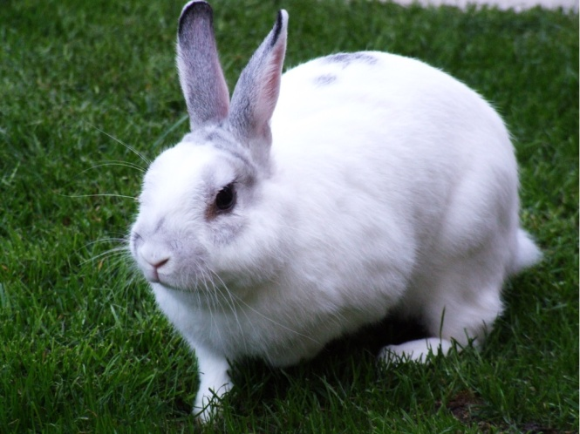
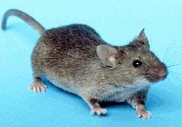
Septic AKI Models
Animal used matters
Small animals (murine, rabbits) vs. large animals (sheep, dogs, pigs)
Precision to measure cardiac performance
Renal blood flow variable
Applicability to humans to use small animal sepsis model?

Slide 31


Models→Performance?
“Look kid … good against a remote, that’s one thing.
Good against a living? That’s something else.”

Slide 32
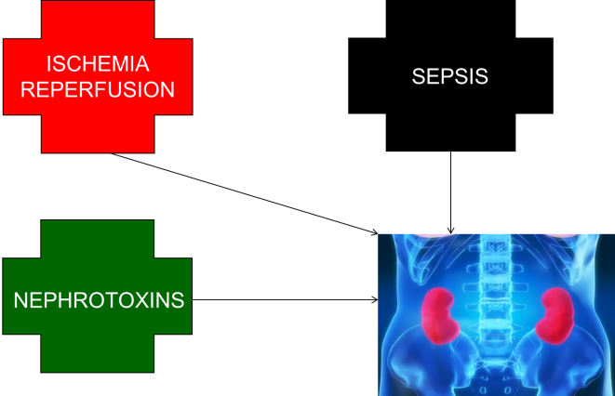
Are these models accurate?
Models have failed!
Therapy based on AKI models
No effect seen in clinical trials thus far
Non-applicable to prevention or treatment
Understanding why is critical (Rosenberger, Contrib Nephrol 2011)
Human AKI is multifactorial
Constellation disease → syndrome, not a disease
Individuals differ in propensity/susceptibility to disease
Morphologic/functional derangements are poorly defined
Ability to track renal physiologic parameters is not available
Evolving vs established? Difficult to identify
“Knowledge” of AKI based on experimental models may be flawed!

Slide 33
Are these models accurate?
Renal structure/function varies
Between animals/species and age
Renal development/embryogenesis differs
Even amongst same species (species of rat and renal papilla)
How are they dissimilar to humans?
Example – gentamicin dose needed higher
Experimental AKI may be affected by confounding factors
Fluid status, temperature, blood pressure, anesthesia
Rarely discussed in methods
Partial oxygen tension varies considerably within kidney at baseline
Most Clinical AKI (adult and pediatric) occurs with comorbidities
Experimental AKI occurs in healthy animals

Slide 34
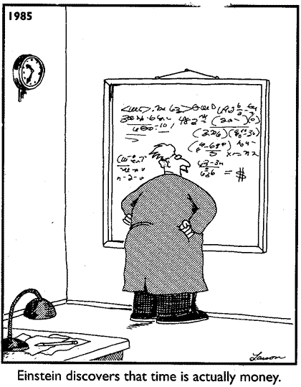
Are these models accurate?
Model of AKI | Simplicity | Reproducibility | Human parallel?
Ischemia-reperfusion | +++ | +++ | Not really
Cardiac arrest | + | No | Likely
Gentamicin toxin | +++ | +++ | Not really
Cispatin toxicity | +++ | +++ | Maybe
LPS infusion | +++ | +++ | Not really
Bacteria | +++ | + | Maybe
CLP | +++ | +++ | Likely
Adapted from Heyman, Crit Care Neph

Slide 35
Conclusions
AKI models….
Ubiquitous
Sometimes easy, sometimes complicated
Variable, highly variable
May provide some sensitive but not specific information
Cell culture/isolated nephrons are likely insufficient
Whole organ/in vivo studies are essential
Relevance…
Must be tempered
Appropriate clinical parallel must be used

Slide 36
Acknowledgements
Cincinnati Children’s Hospital
Division of Critical Care
Hector Wong
Derek Wheeler
Emily Donaworth
Center for Acute Care Nephrology
Stuart Goldstein
Prasad Devarajan

